Slide 1
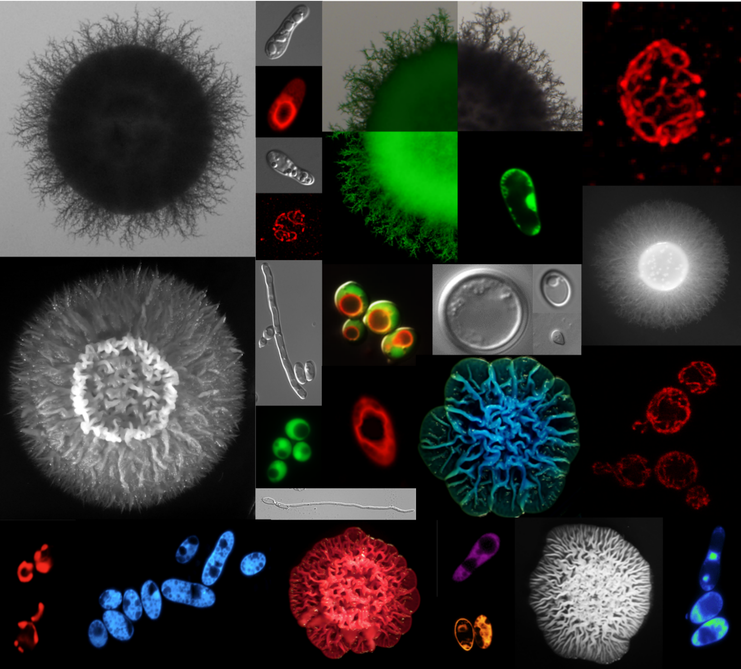
Elucidating the Metabolic Drivers of Fungal Morphogenesis
Presented by: M Adishree
Junior Research Fellow
CSIR-CCMB
Guided by: Dr. Sriram Varahan

Slide 2
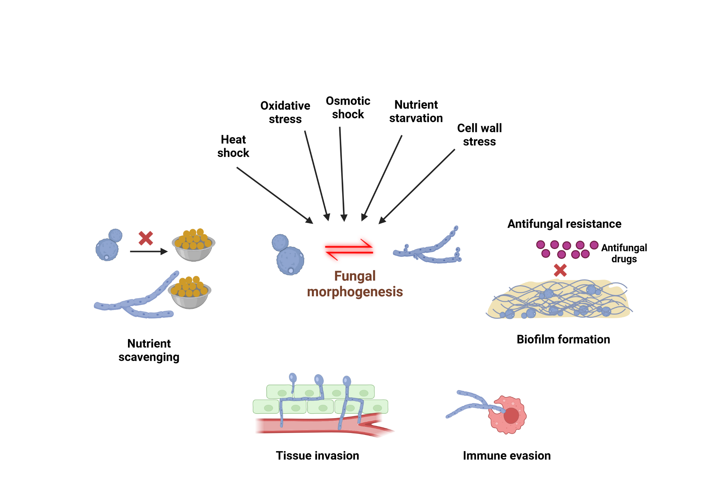
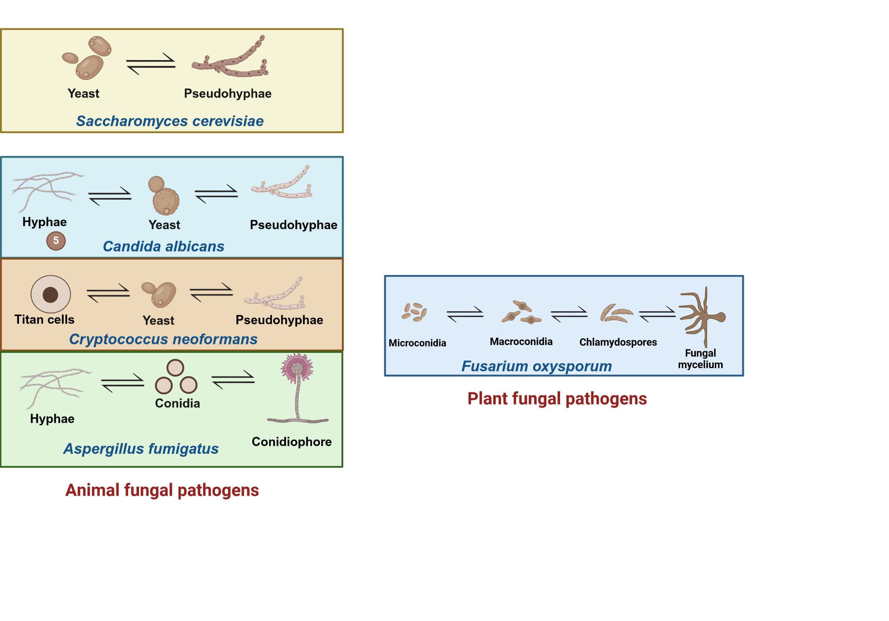
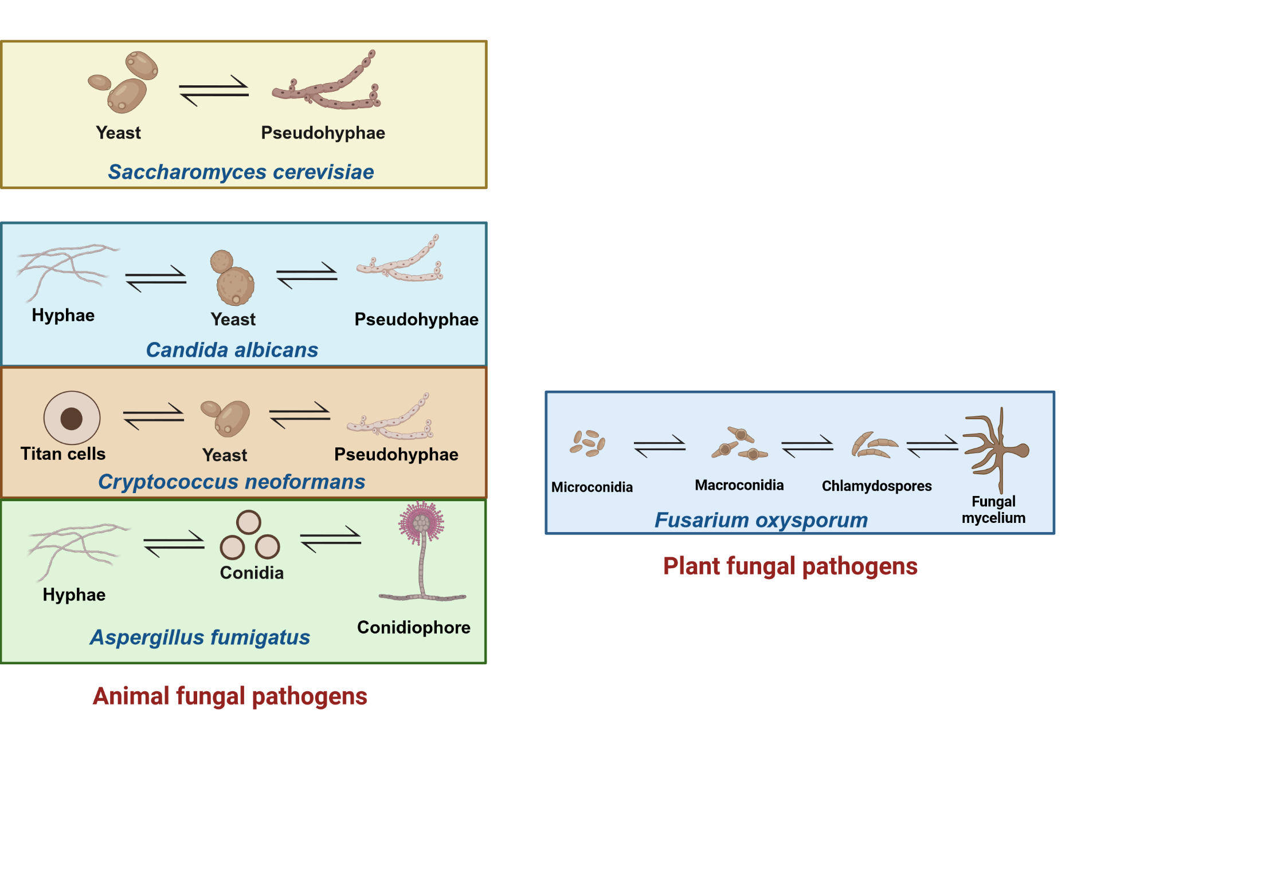
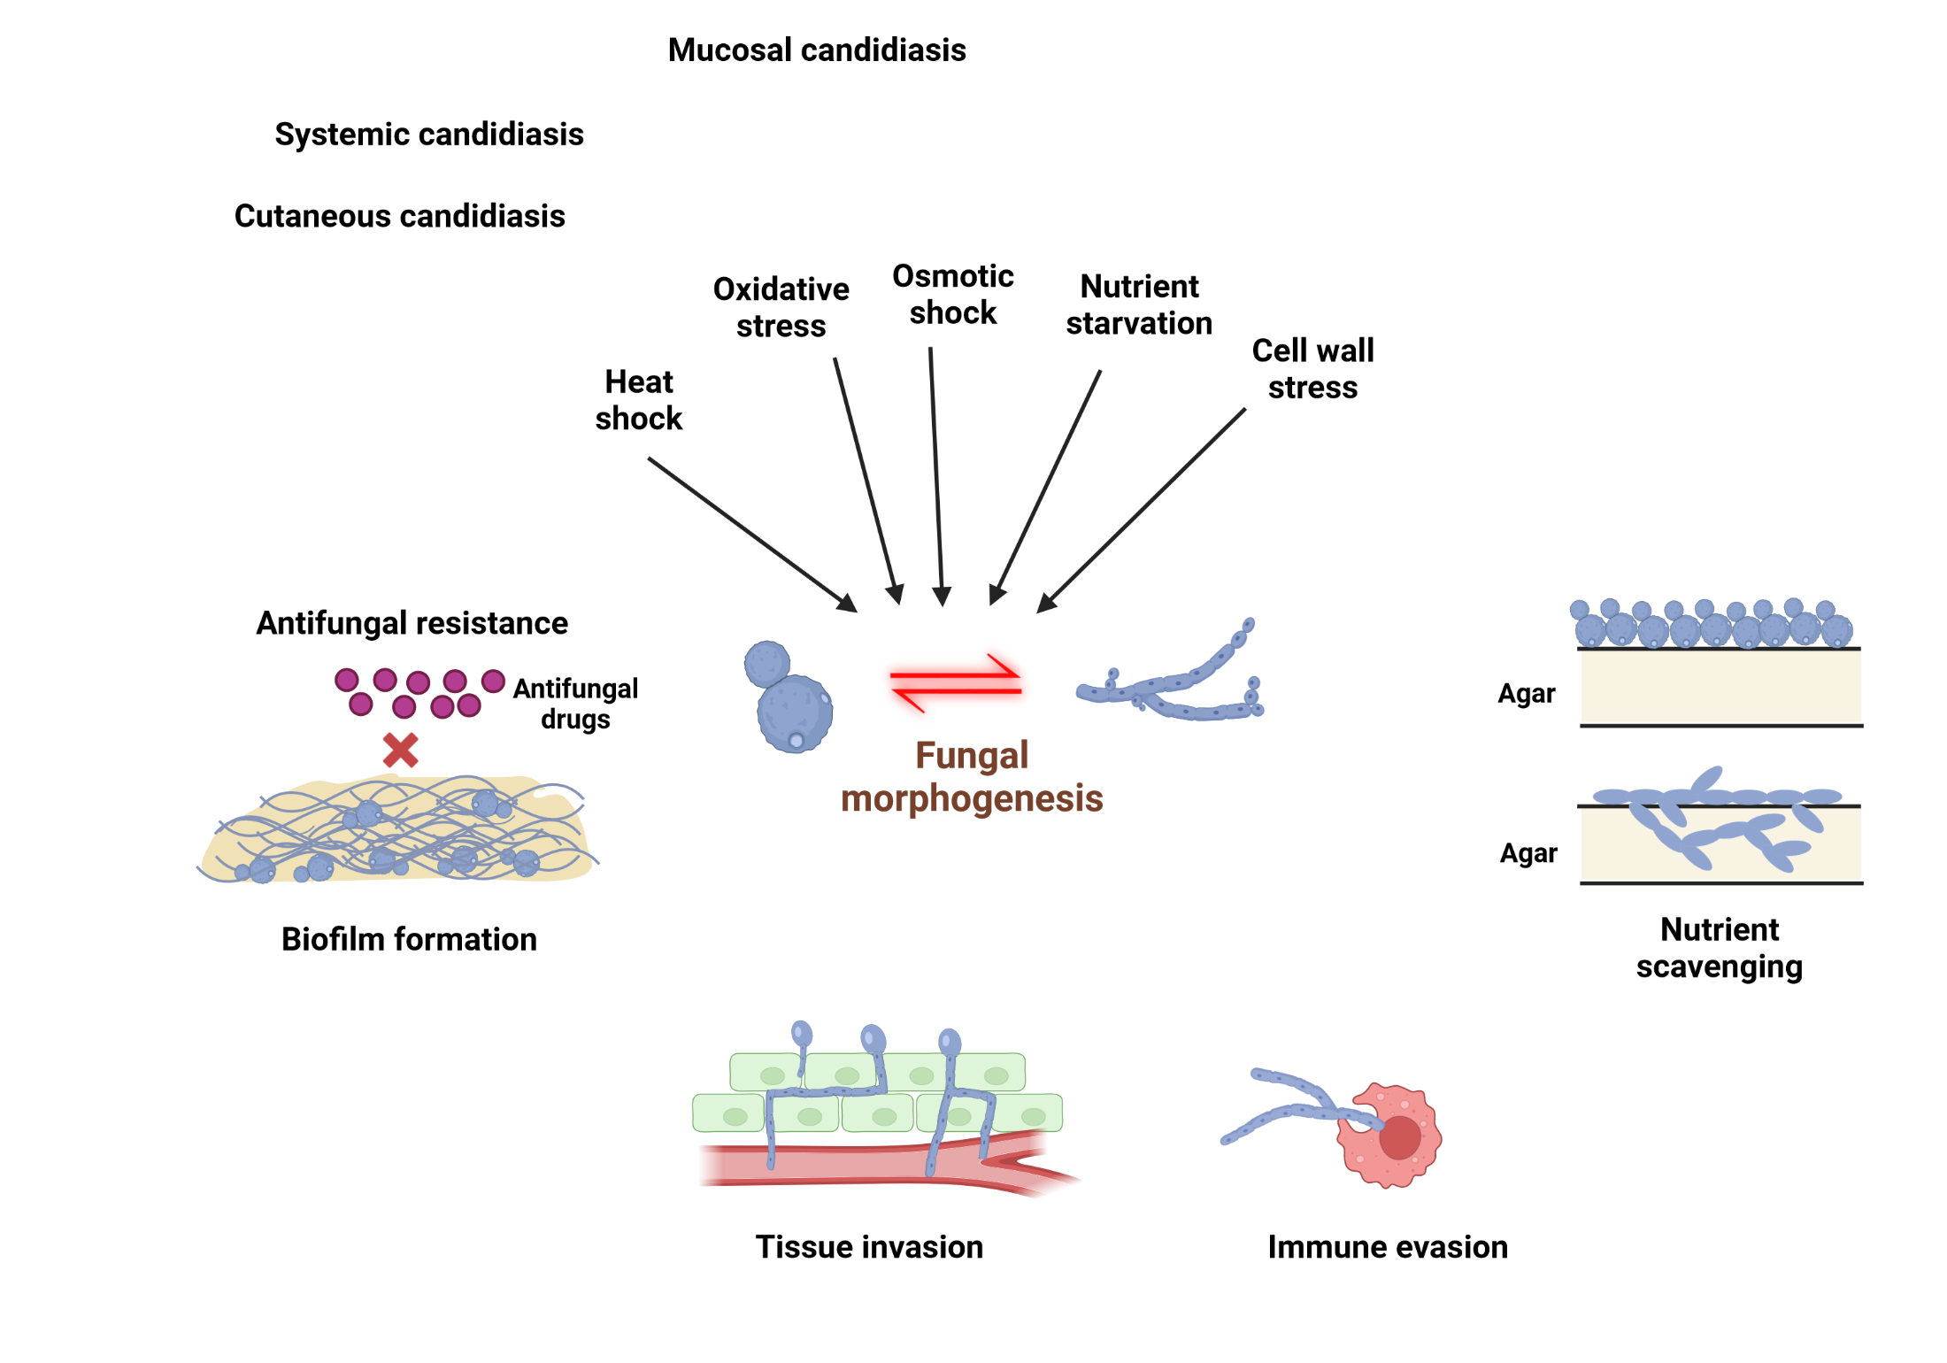
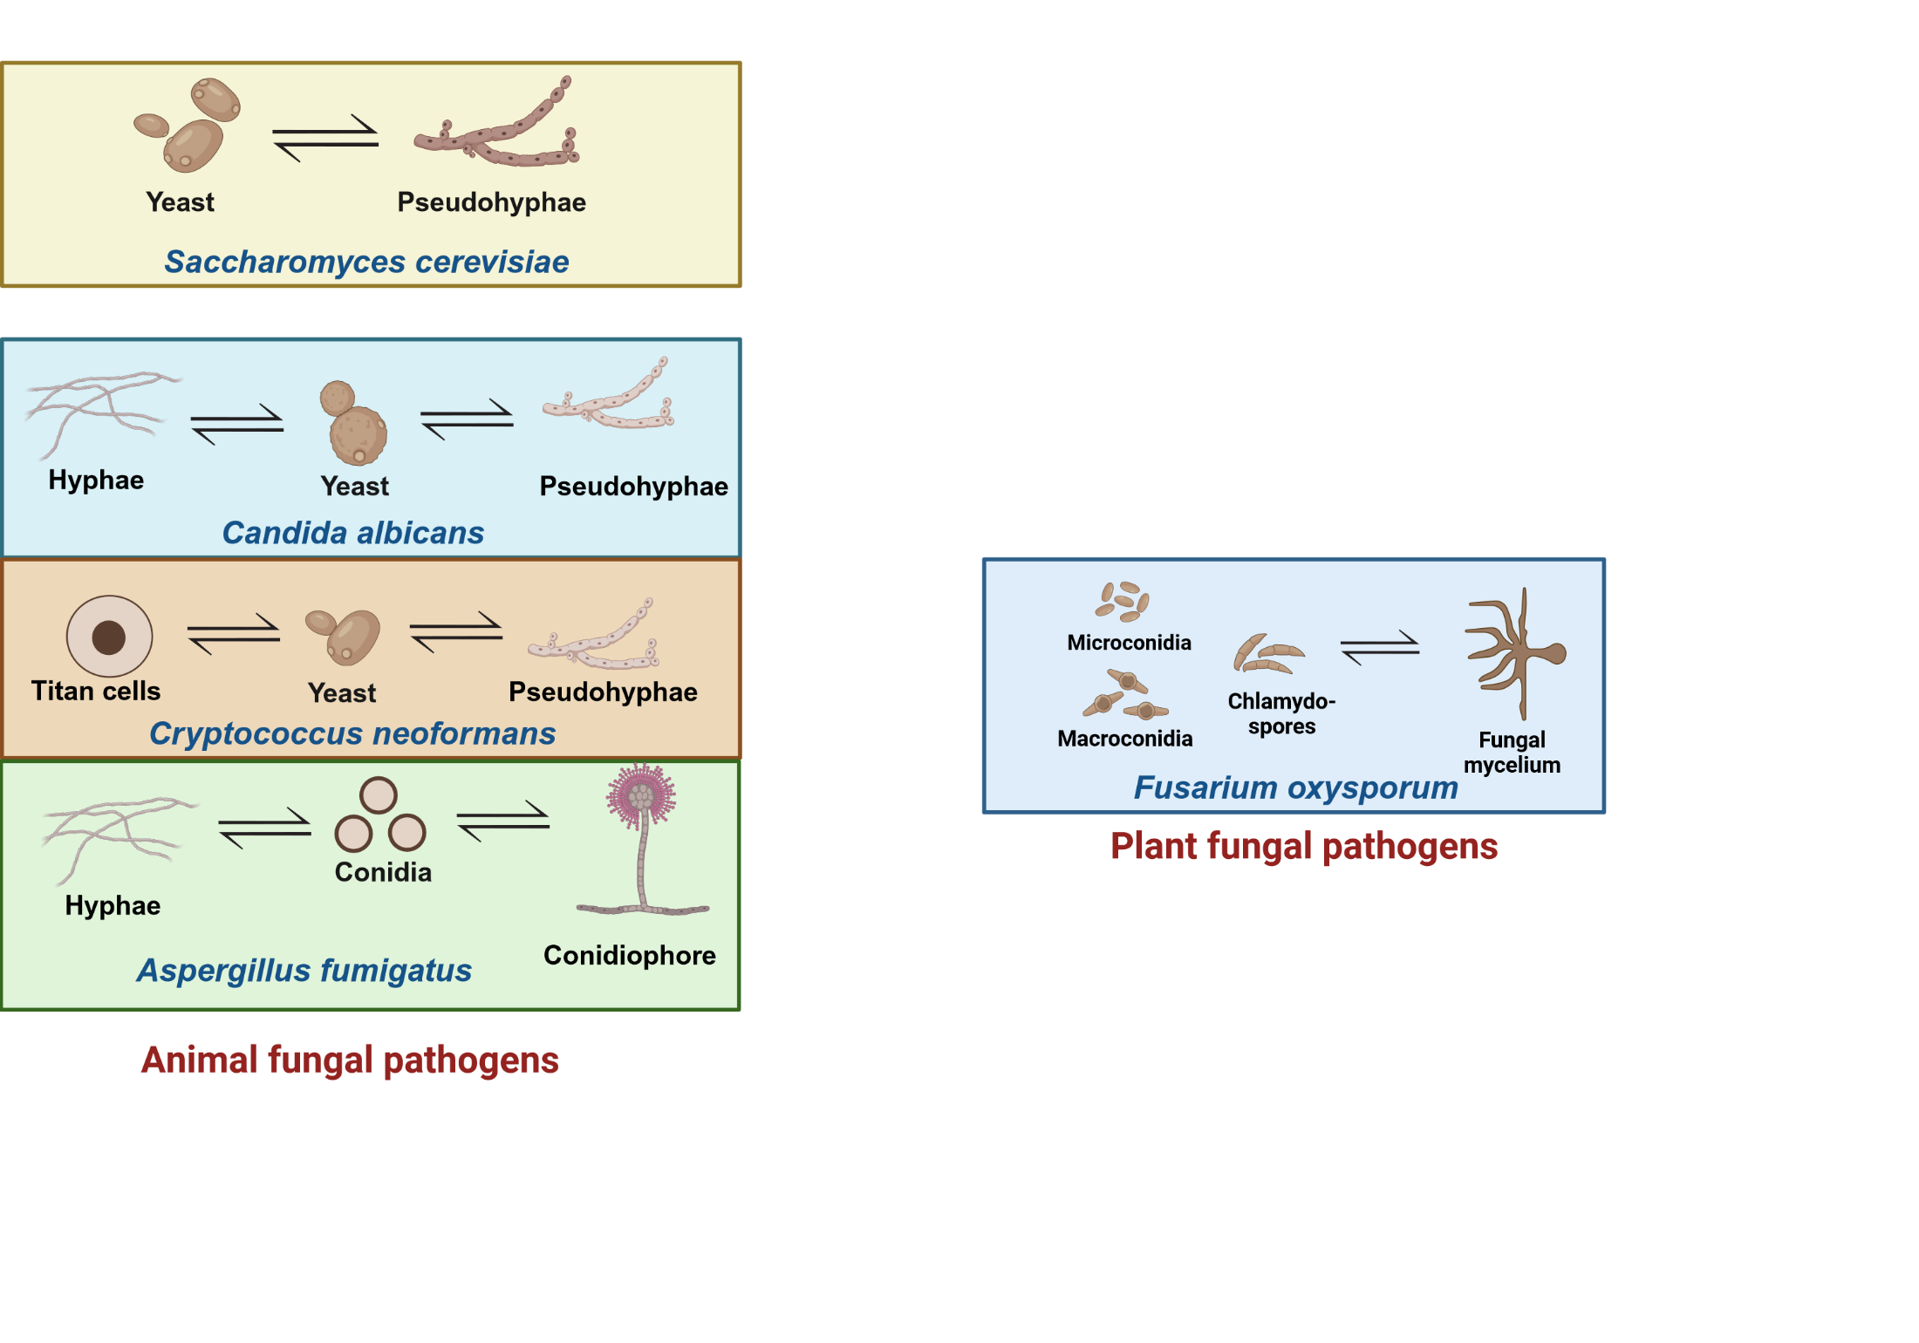
Fungal Morphogenesis
Images are created by Biorender.

Slide 3
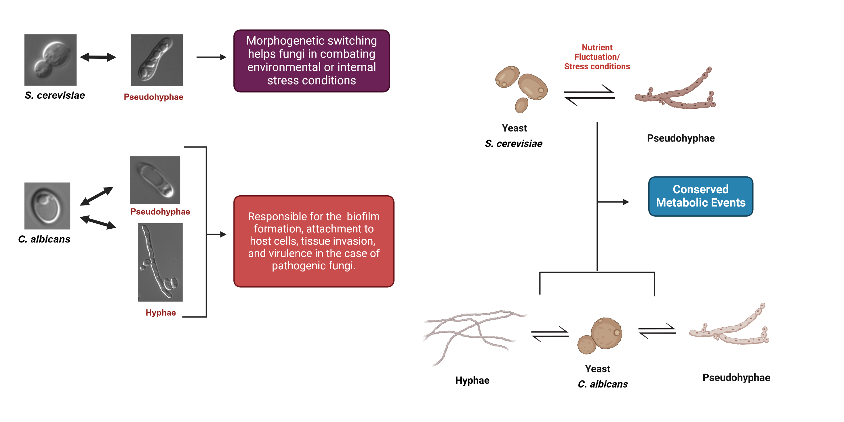
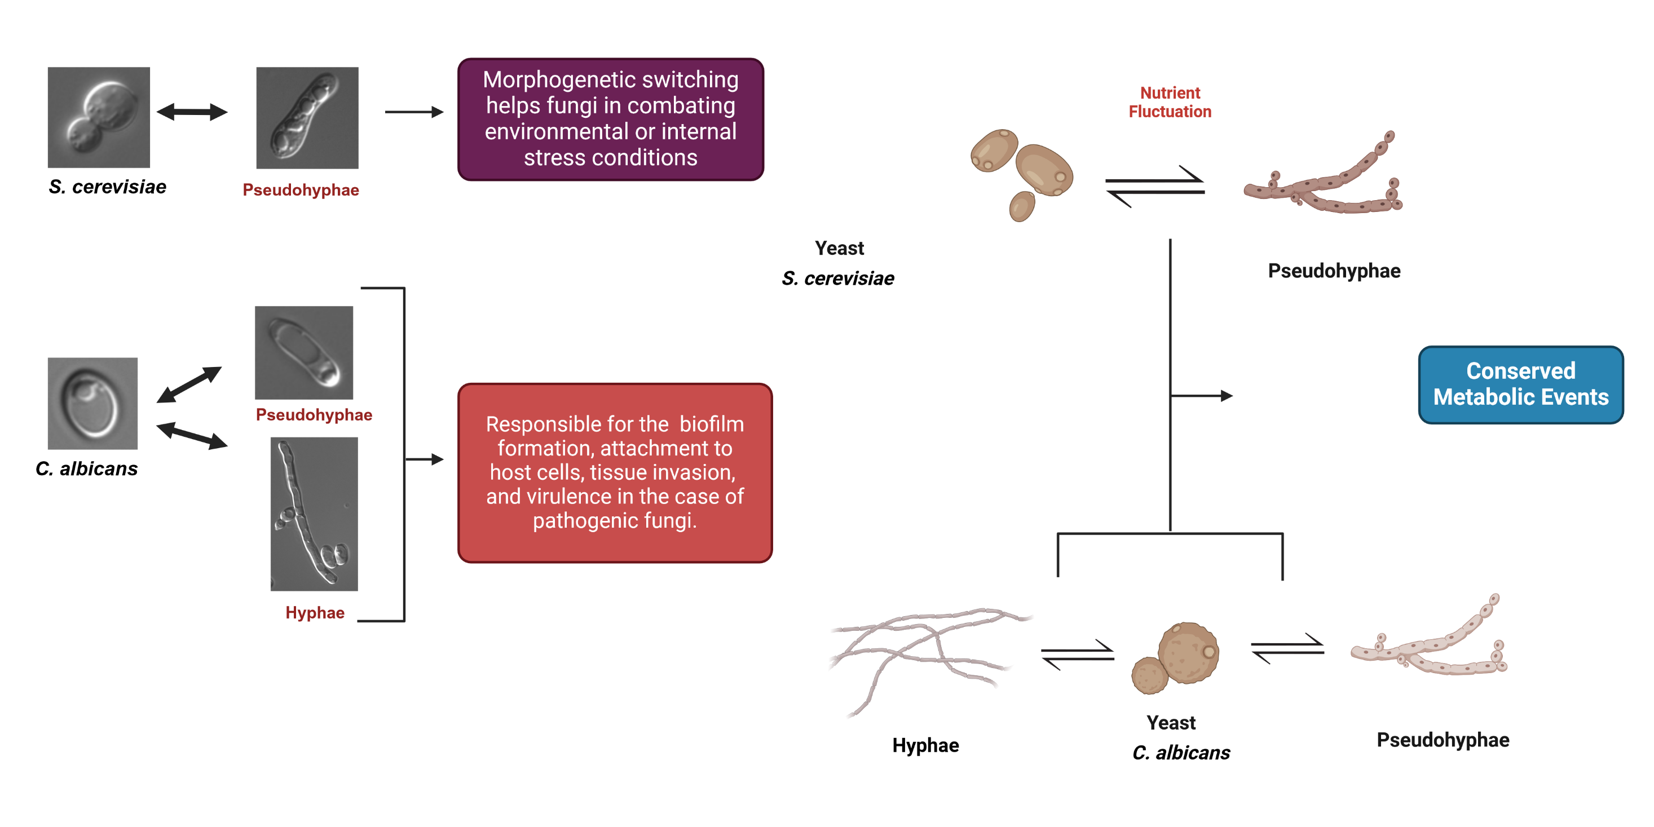
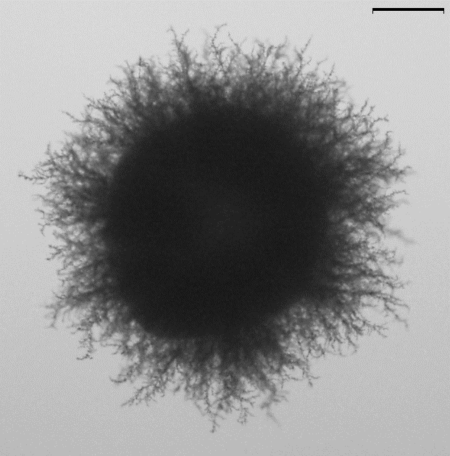
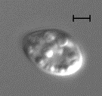
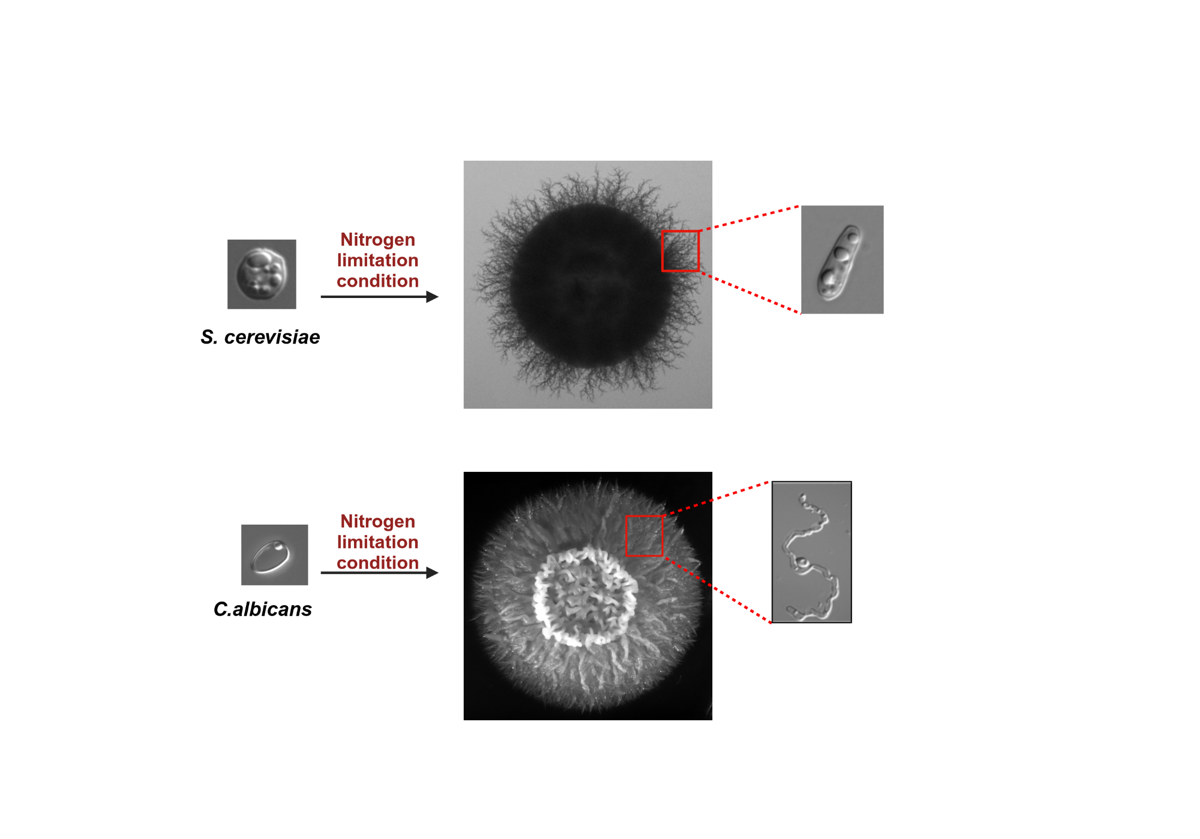



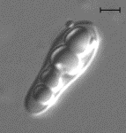

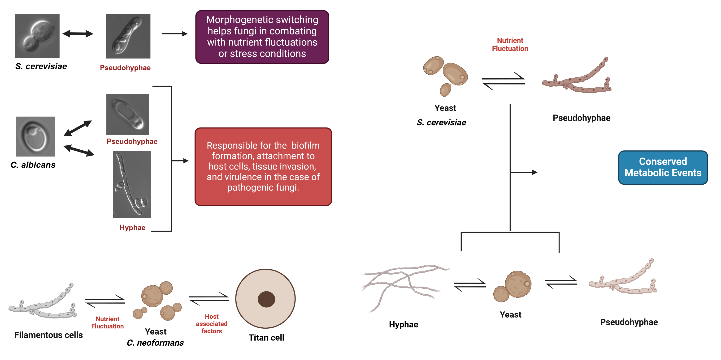
Fungal Morphogenesis
Scale bar=2µm
Scale bar=1mm
Scale bar=2µm
Nitrogen limitation is necessary for pseudohyphal differentiation, but is it sufficient?
Images are created by Biorender.

Slide 4
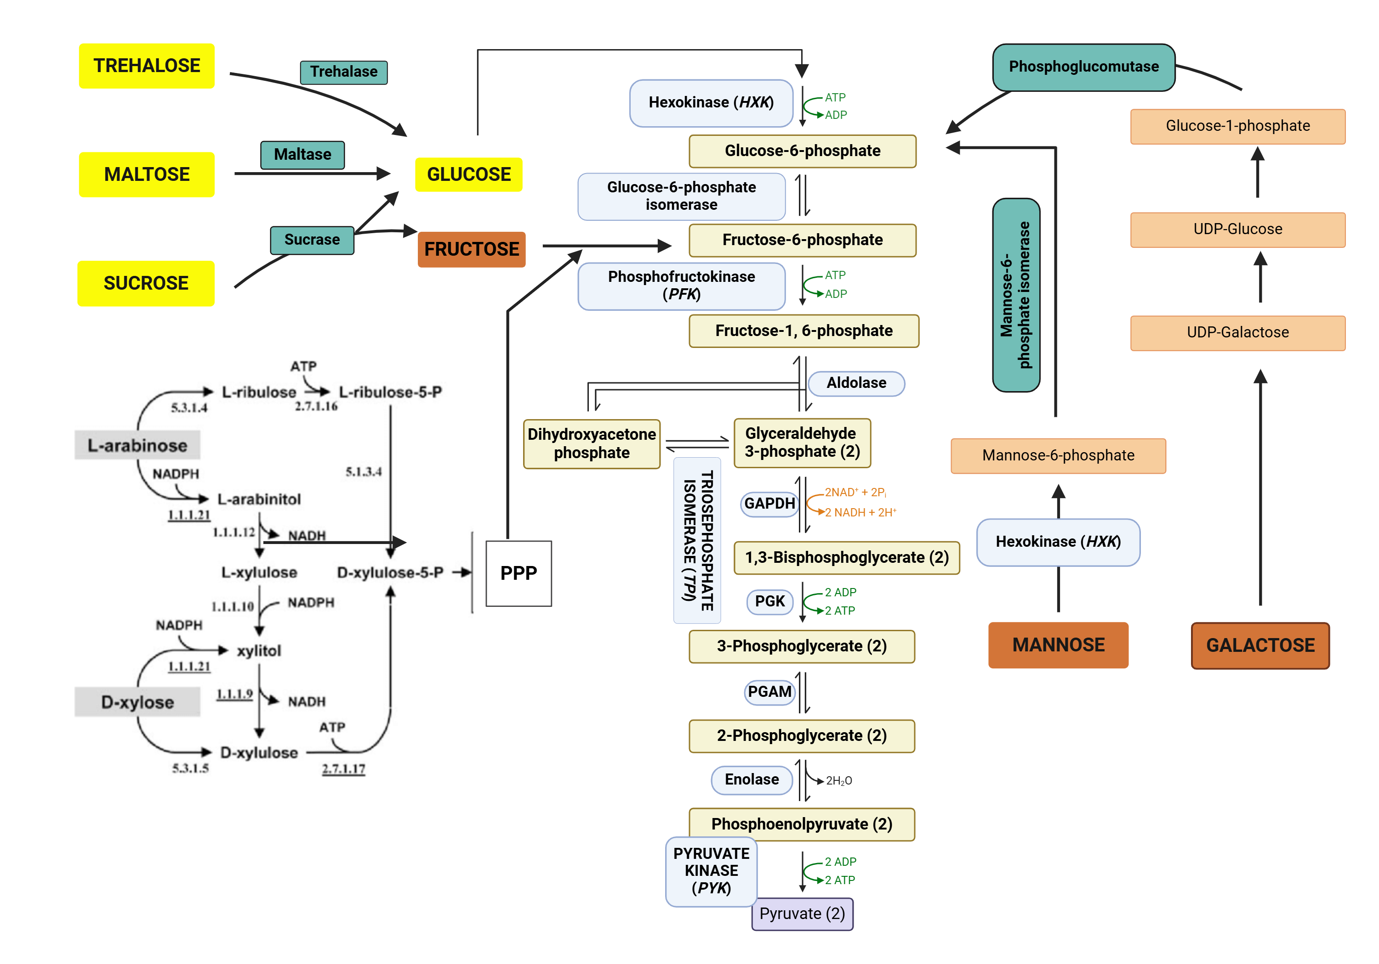
Fermentable carbon sources that ultimately feed into glycolysis trigger pseudohyphal differentiation.

Slide 5
Recapitulation
Glucose influences pseudohyphal differentiation in a concentration–dependent manner
Ability of cells to breakdown glucose is critical for pseudohyphal differentiation
Ability of cells to metabolize glucose via glycolysis is critical for pseudohyphal differentiation

Slide 6
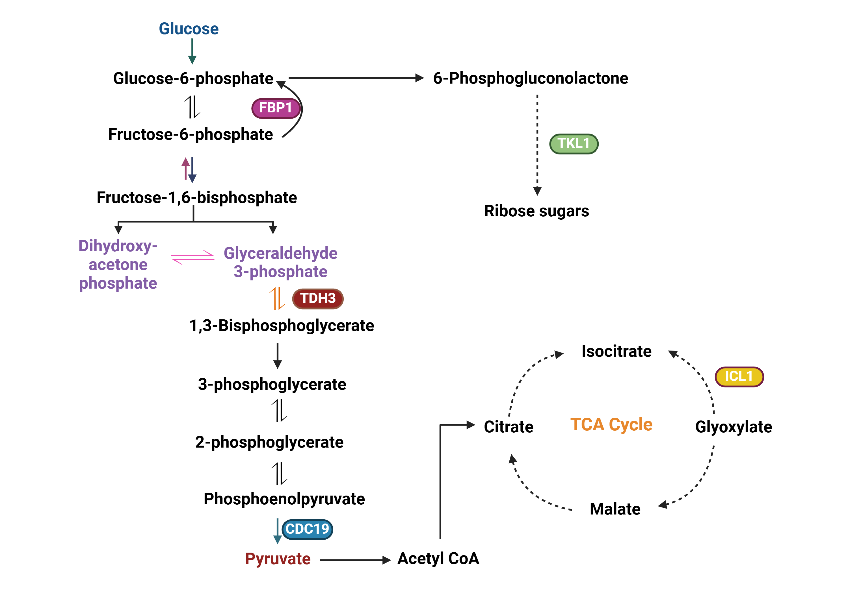
Probing into metabolic state of pseudohyphal cells
Images are created by Biorender.

Slide 7
Probing into metabolic state of pseudohyphal cells
Glucose de-repressed genes
Glucose repressed genes
Phosphoenolpyruvate + ADP
Glyceraldehyde-3-p
D-threo-isocitrate
CDC19
TDH3
ICL1
Pyruvate+ATP
3-phospho glyceroyl phosphate
Glyoxylate + Succinate
6-Phosphogluconolactone
D-fructose-1,6 bis-phosphate
FBP1
TKL1
D-fructose-phosphate + phosphate
Ribose sugars (carbon backbone)

Slide 8
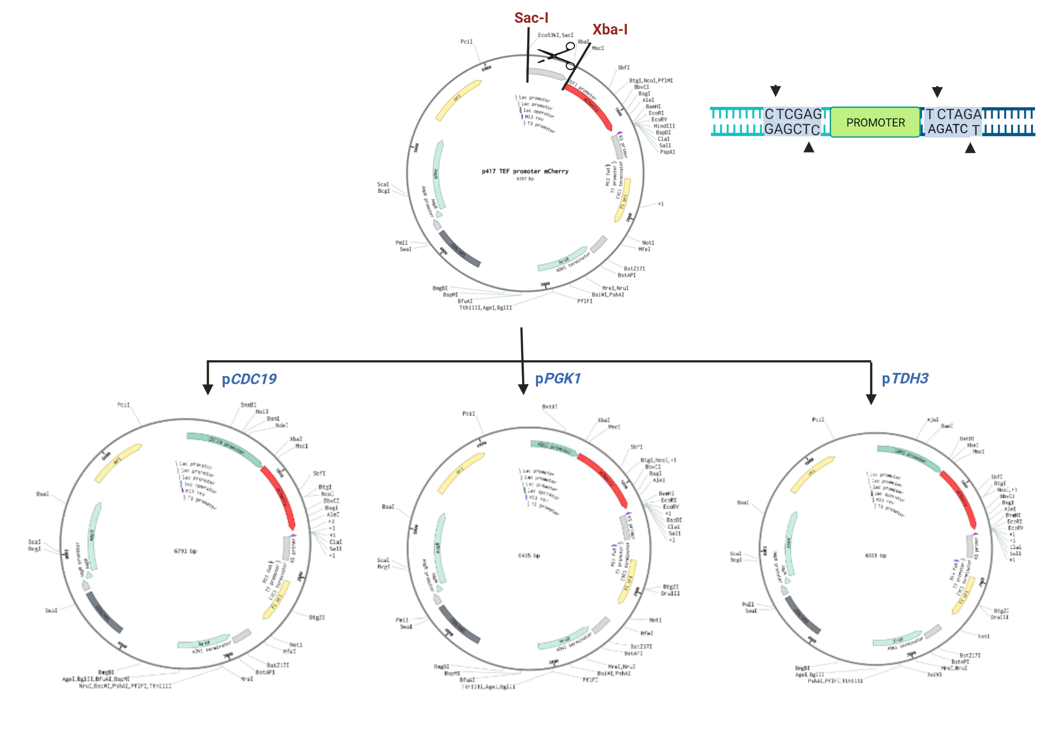

Slide 9
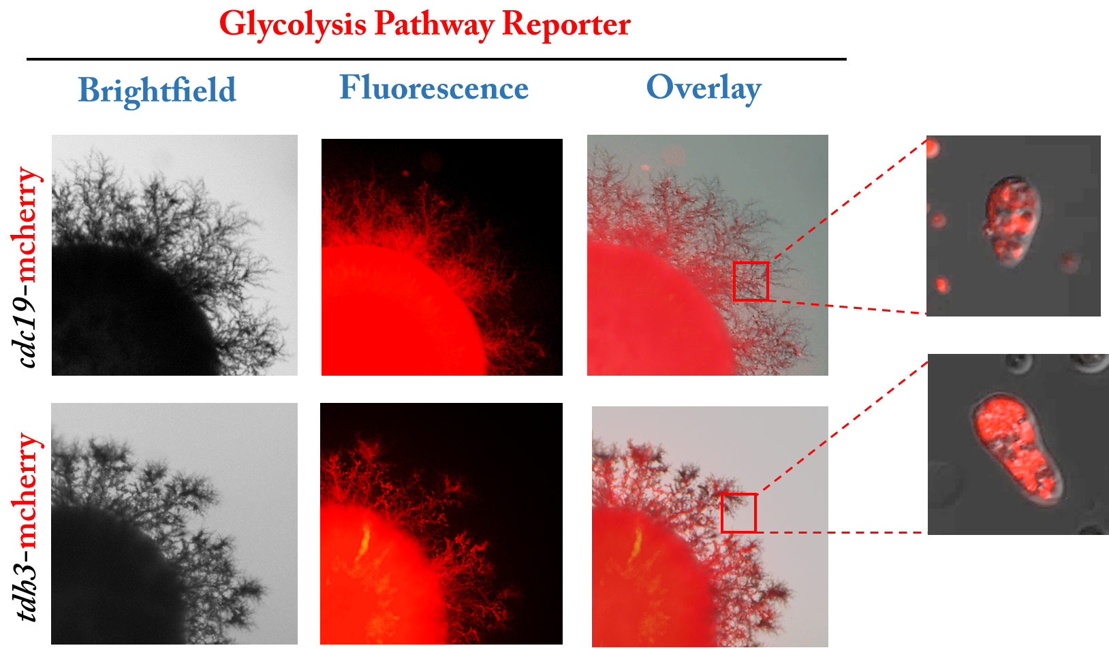
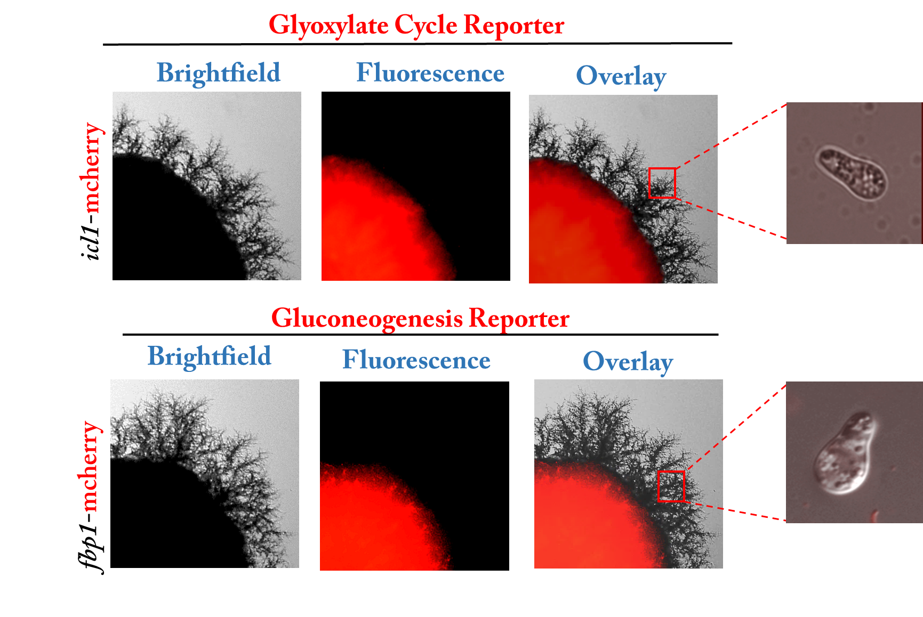
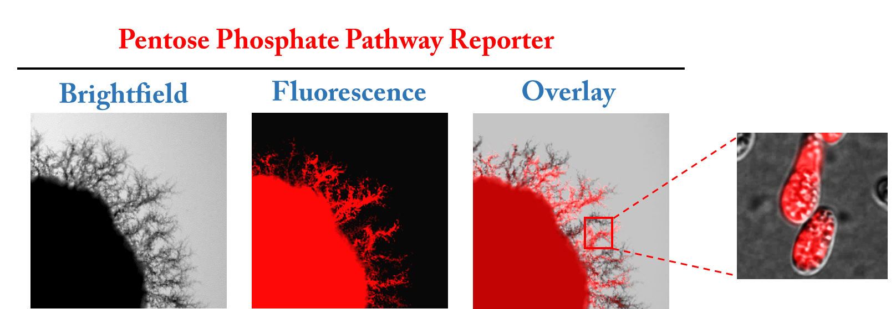

Probing into metabolic state of pseudohyphal cells
Glucose de-repressed pathways
Glucose repressed pathways
Pseudohyphal cells are highly glycolytic even under stress condition.

Slide 10
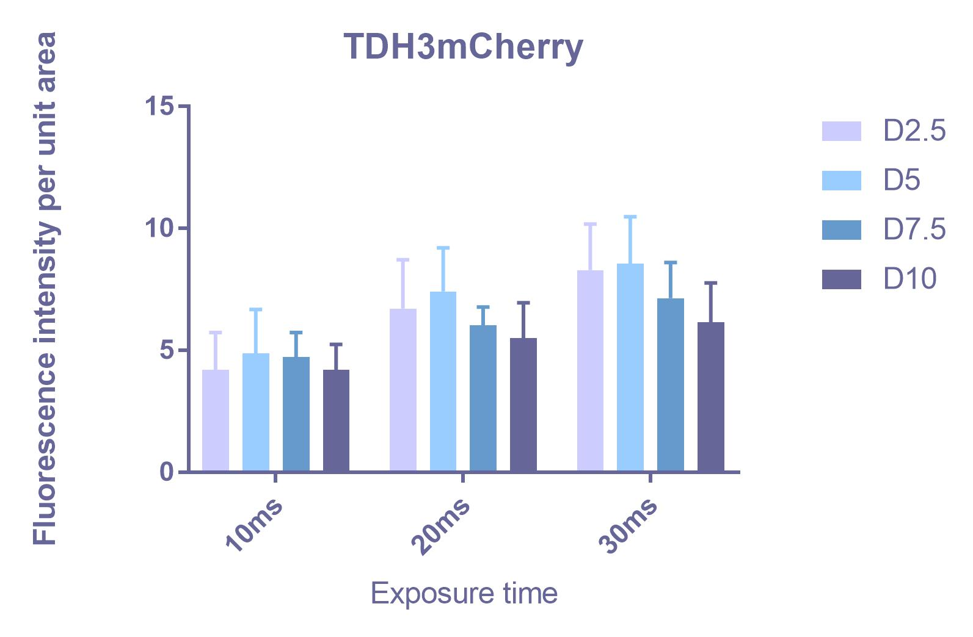
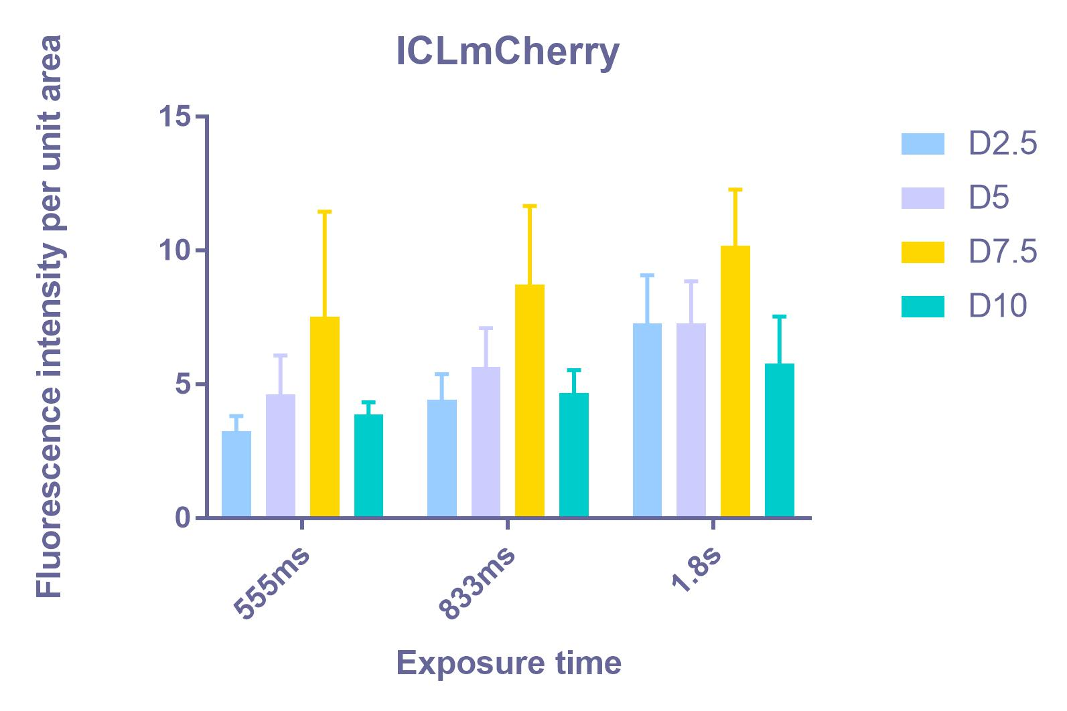
Spatio-temporal expression of central carbon metabolism
Glucose de-repressed pathways
Glucose repressed pathways
A notable increase in glycolysis is observed on Day-5.

Slide 11
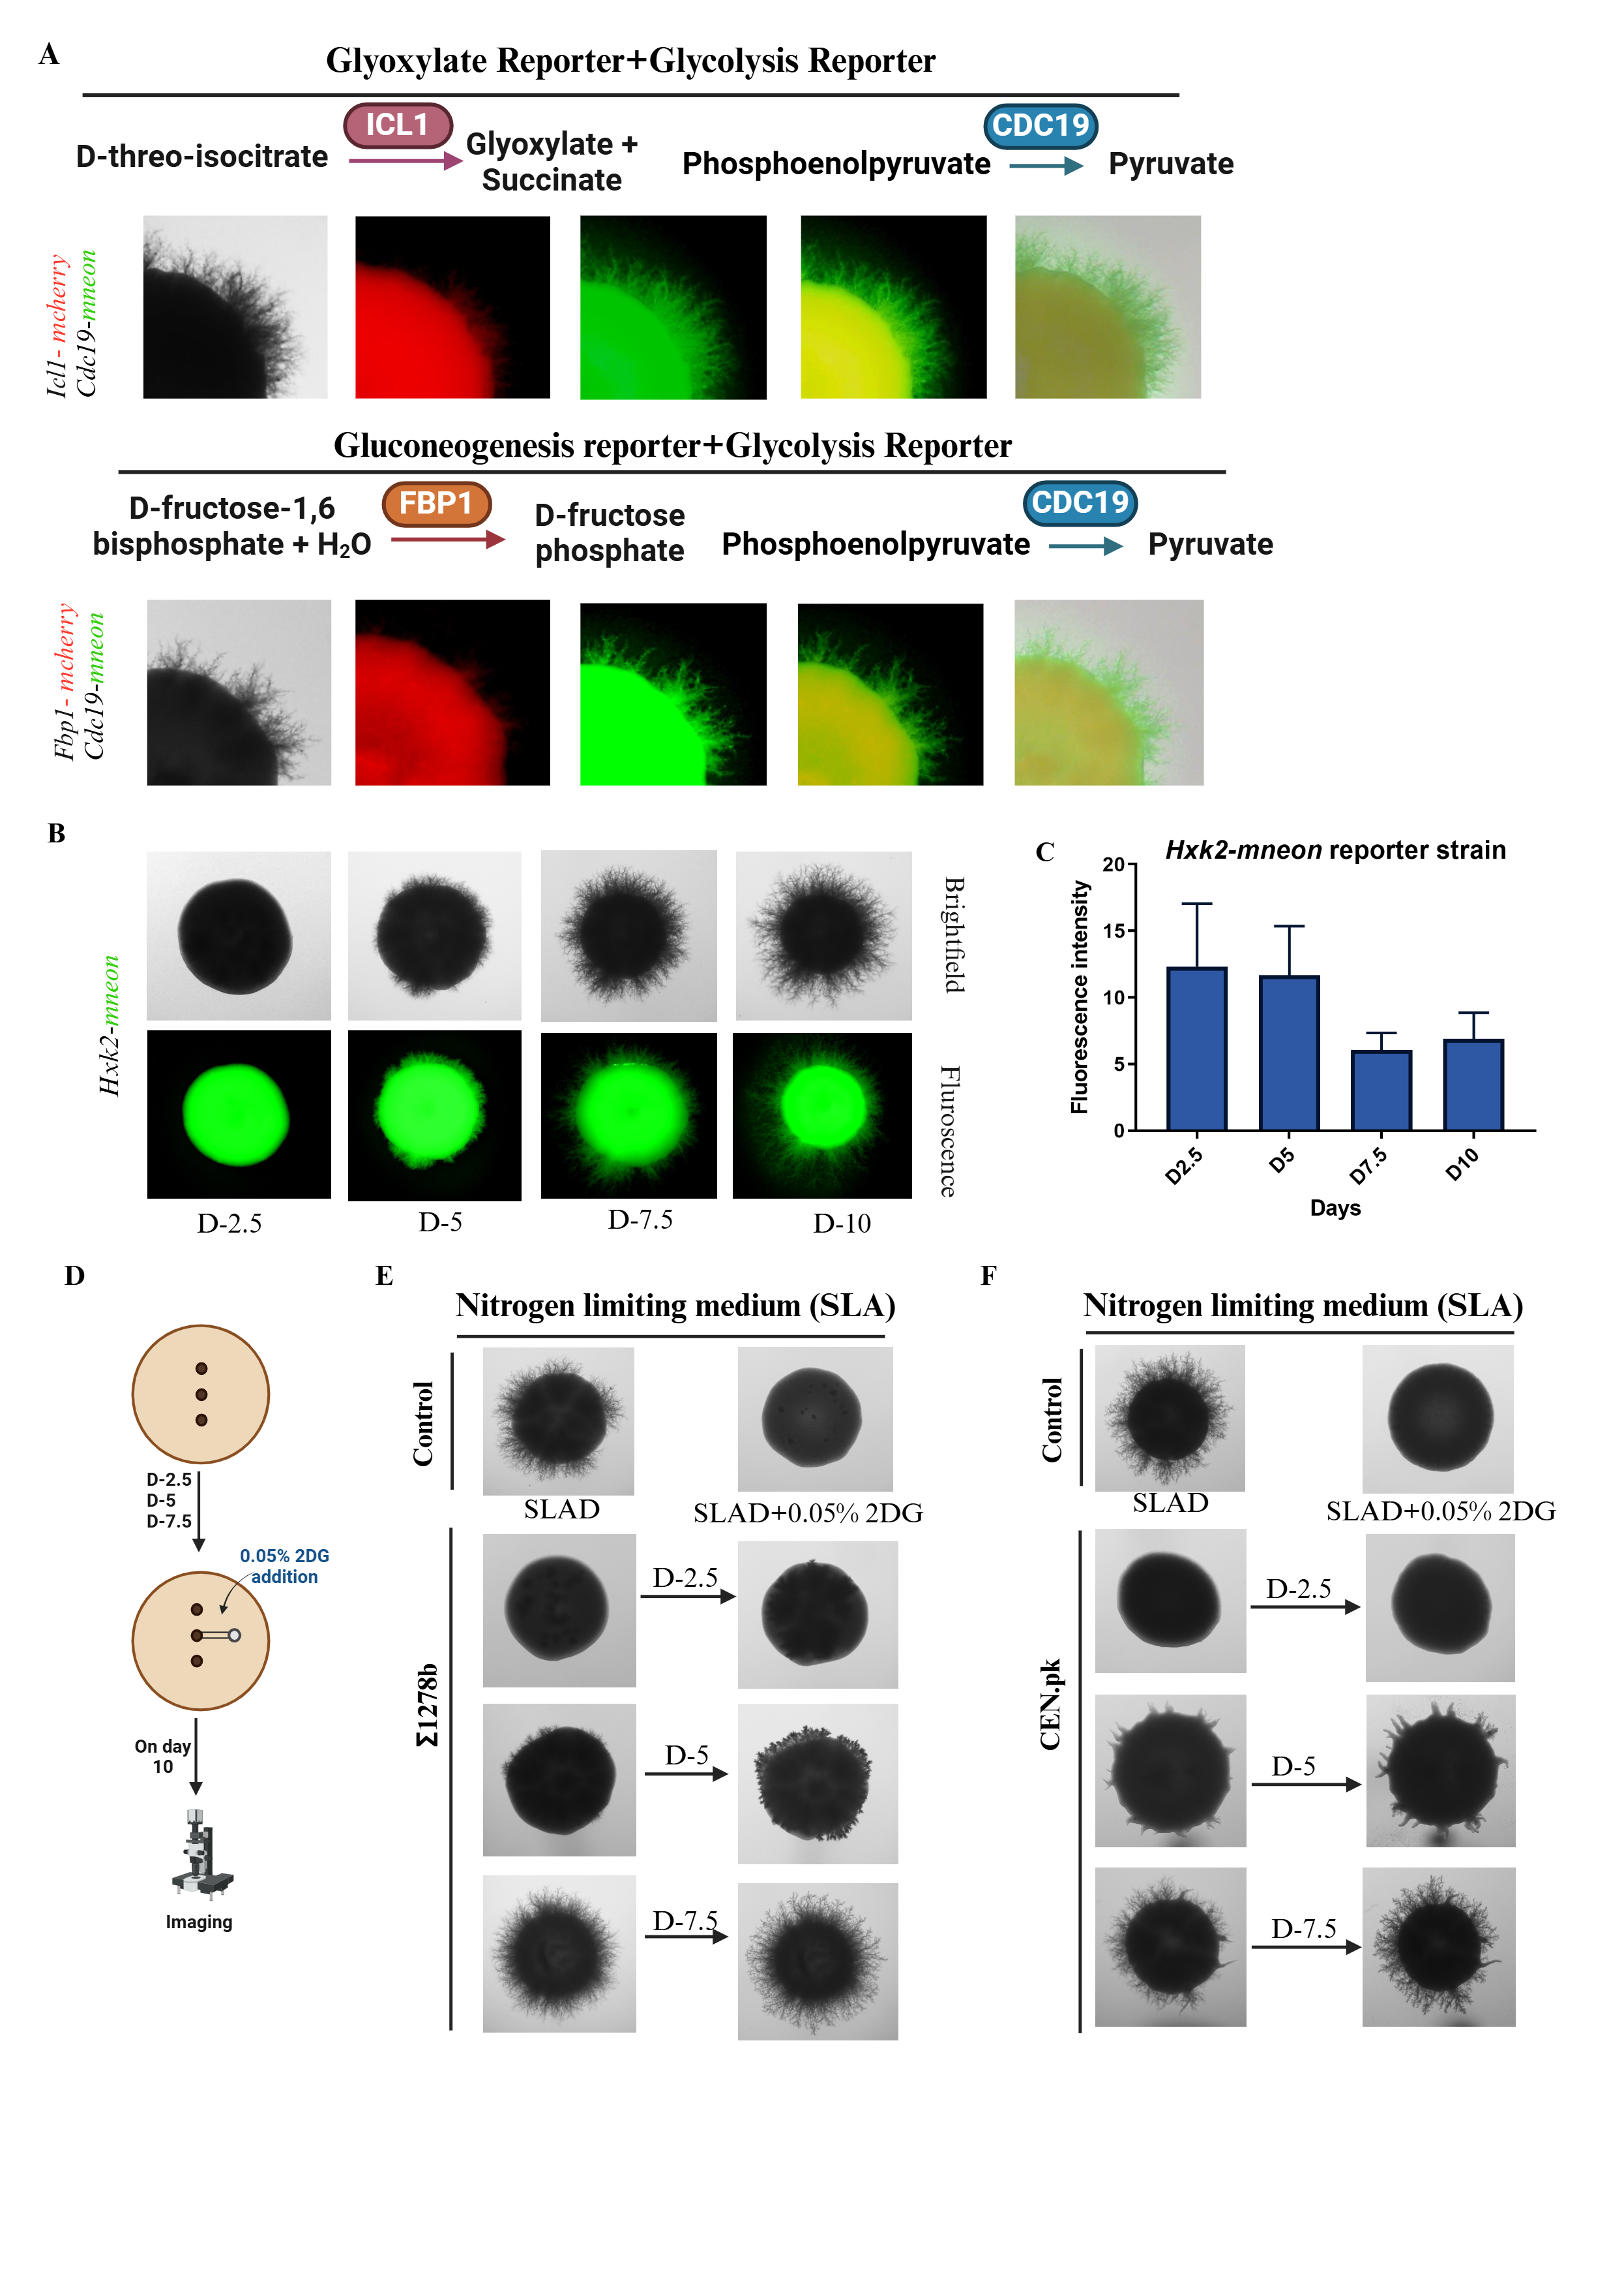
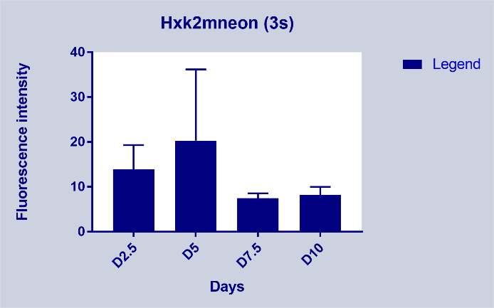
Glyoxylate + Glycolysis reporter
Hxk2-mneon

Slide 12
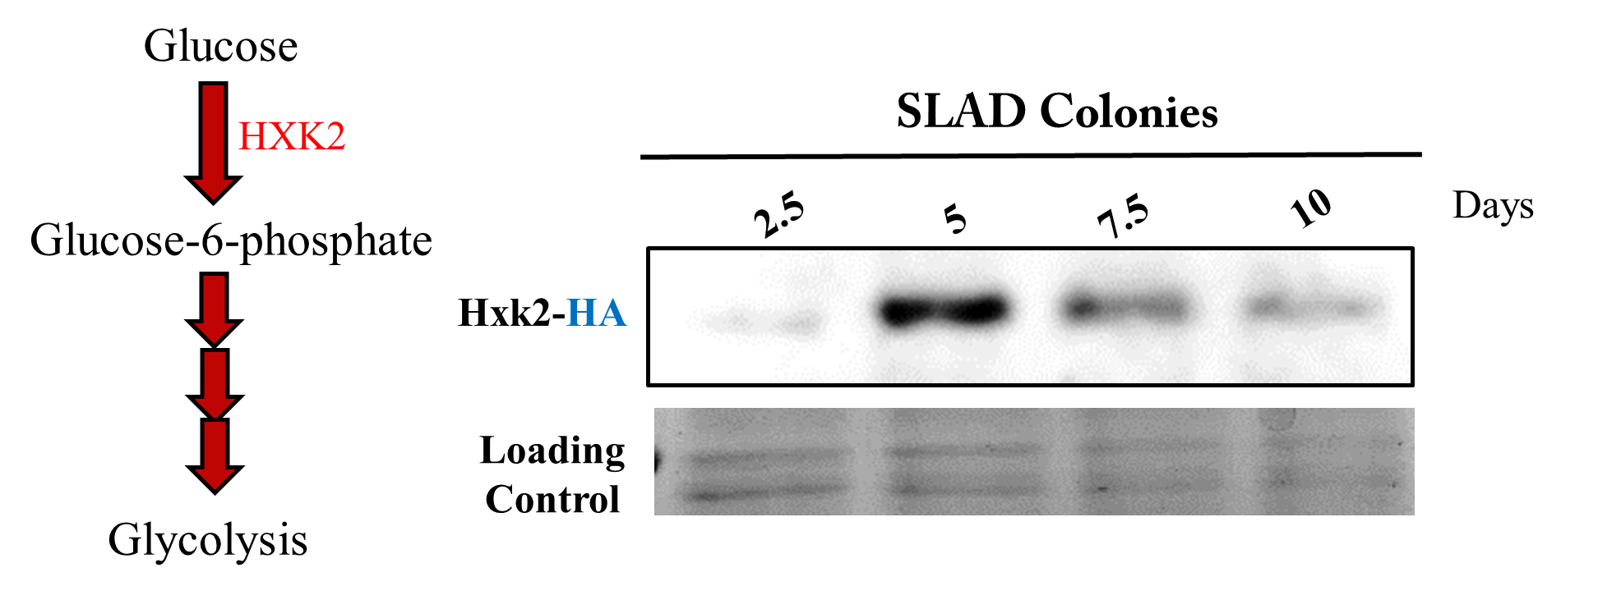
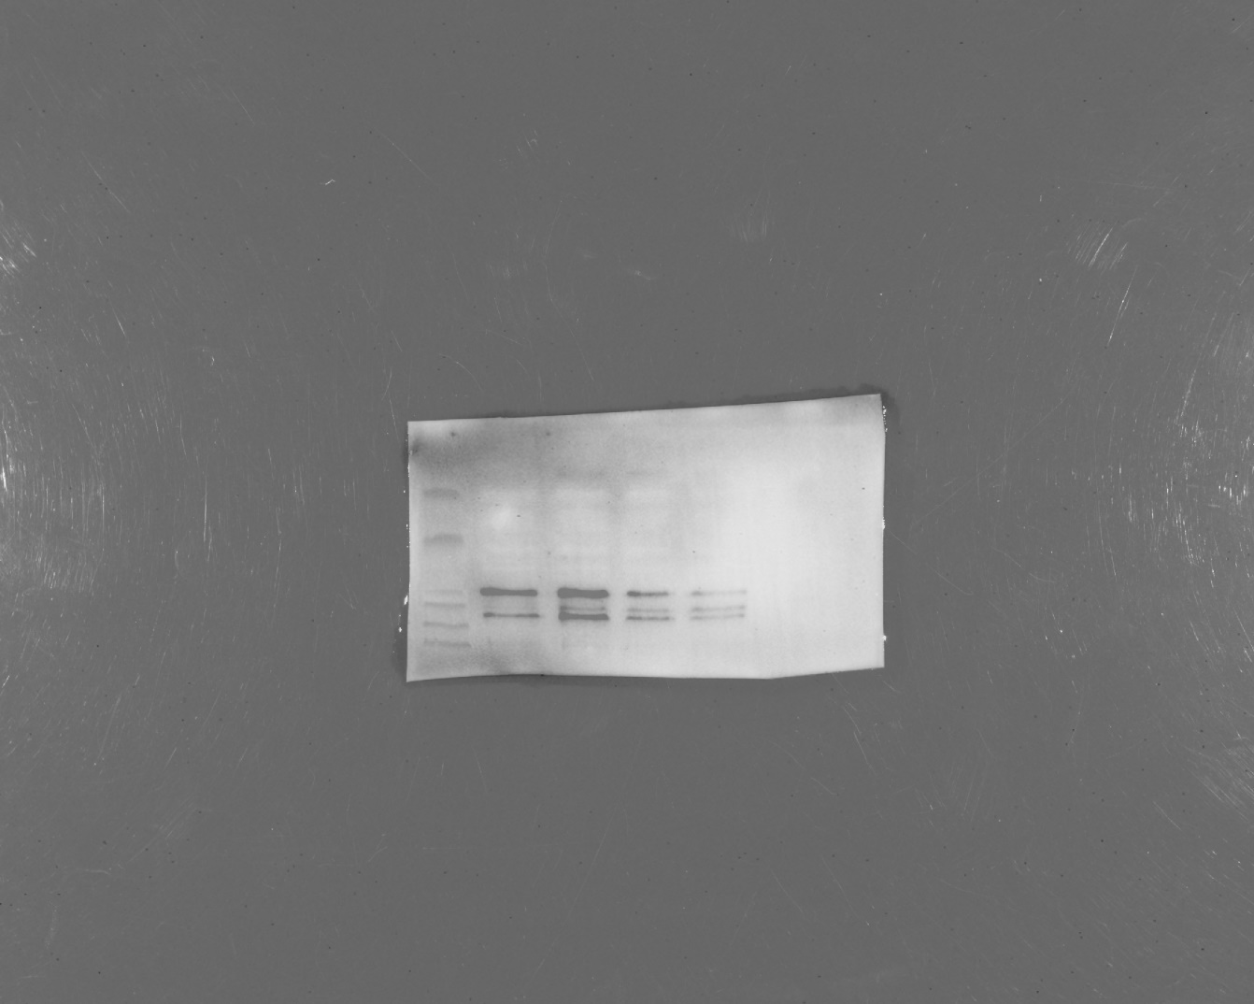
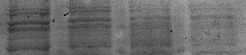
Spatio-temporal expression of central carbon metabolism
SLAD colonies
Phosphoenolpyruvate + ADP
2.5
CDC19
5
7.5
10
cdc19_HA
Pyruvate+ATP
Loading control

Slide 13
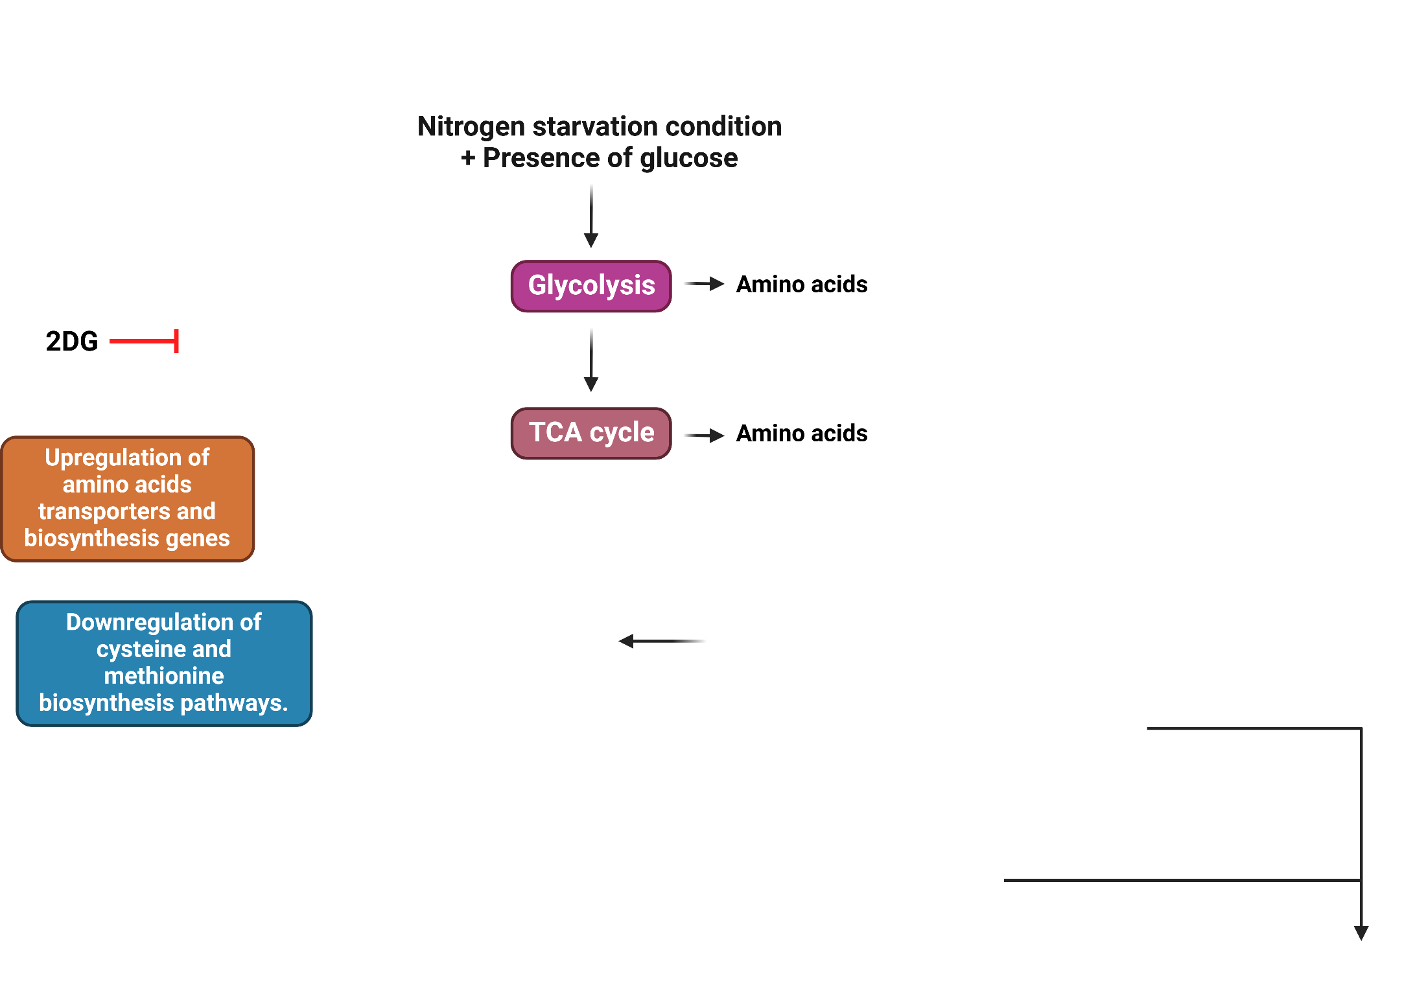
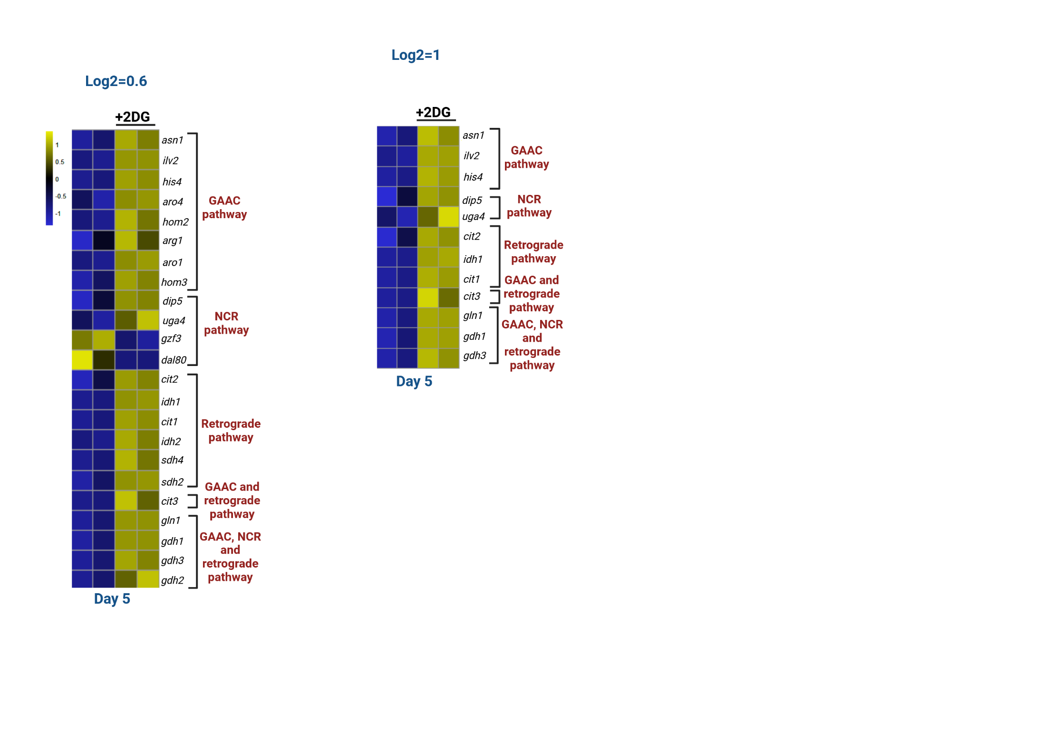
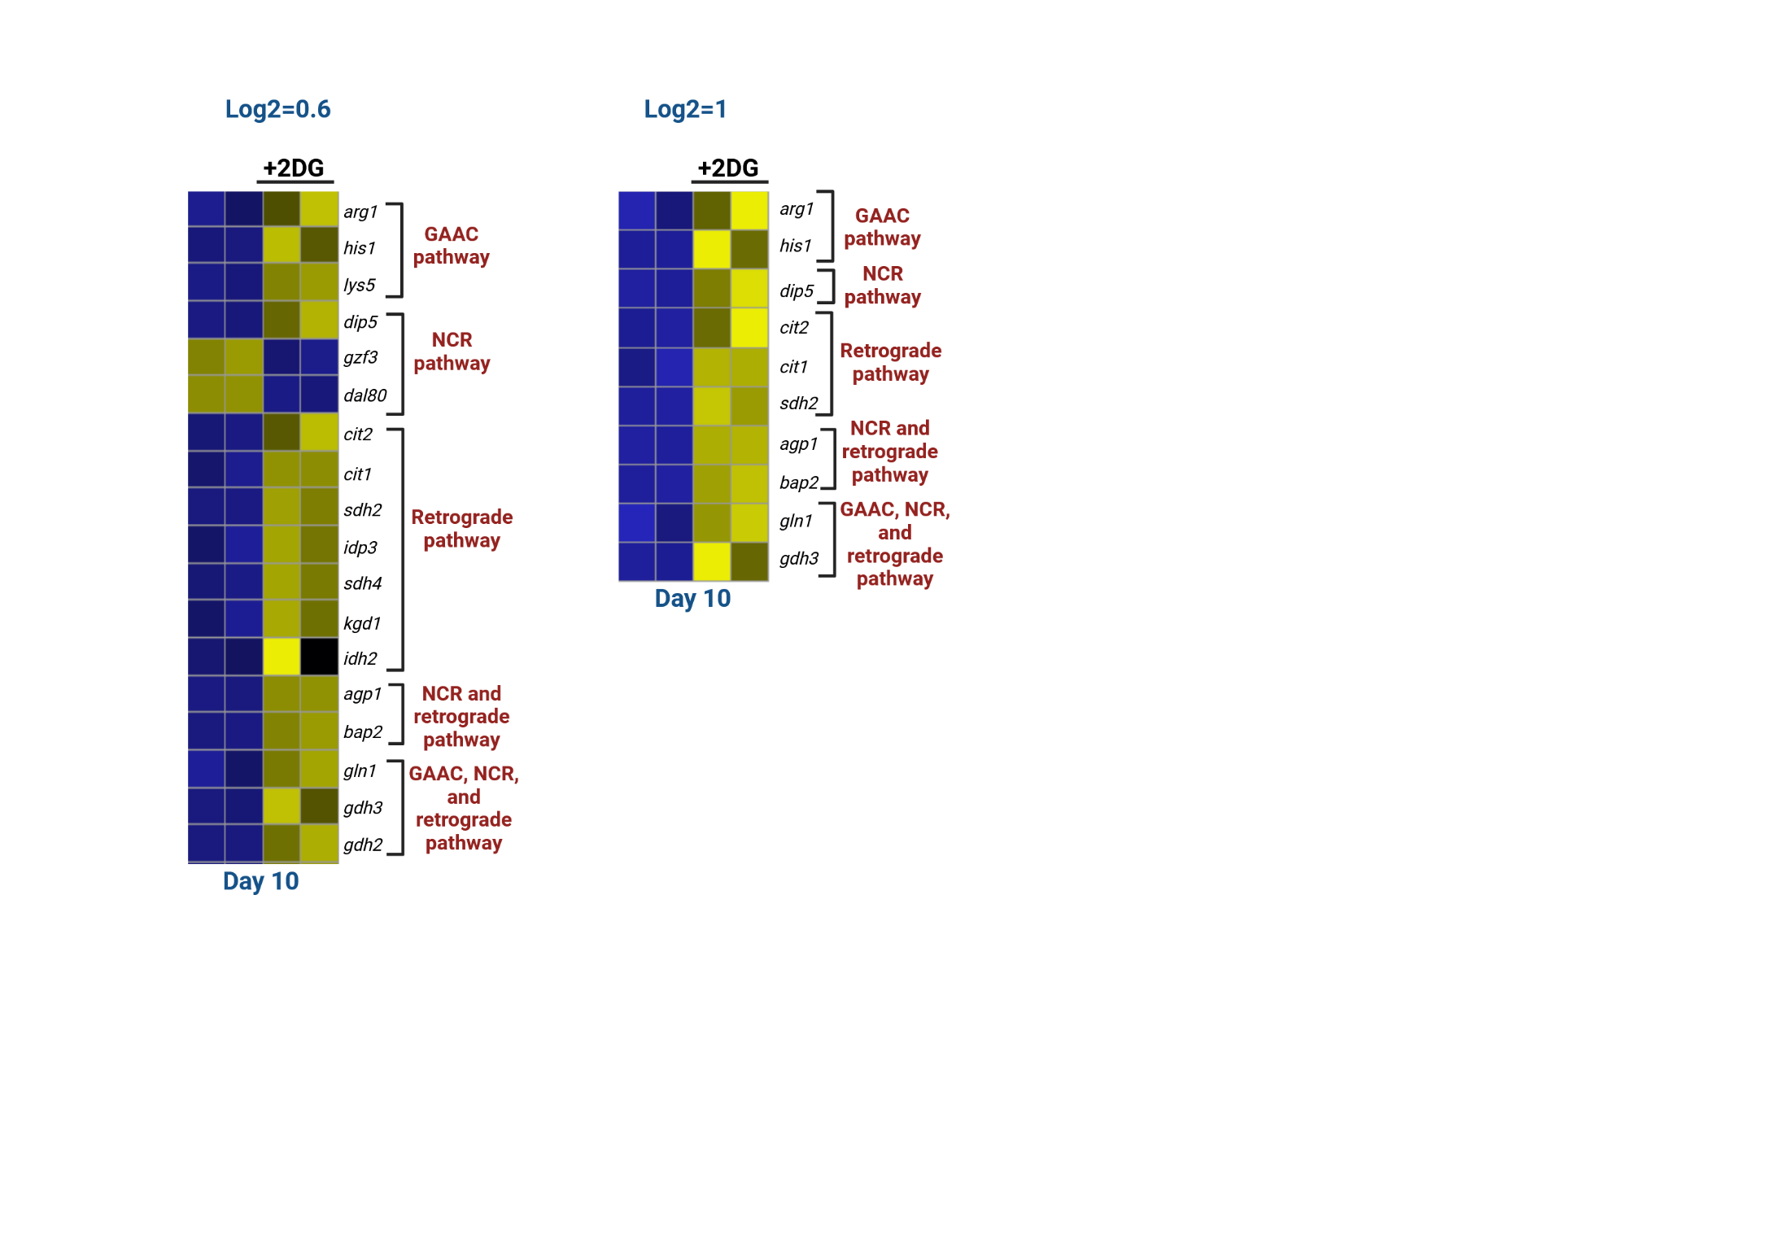
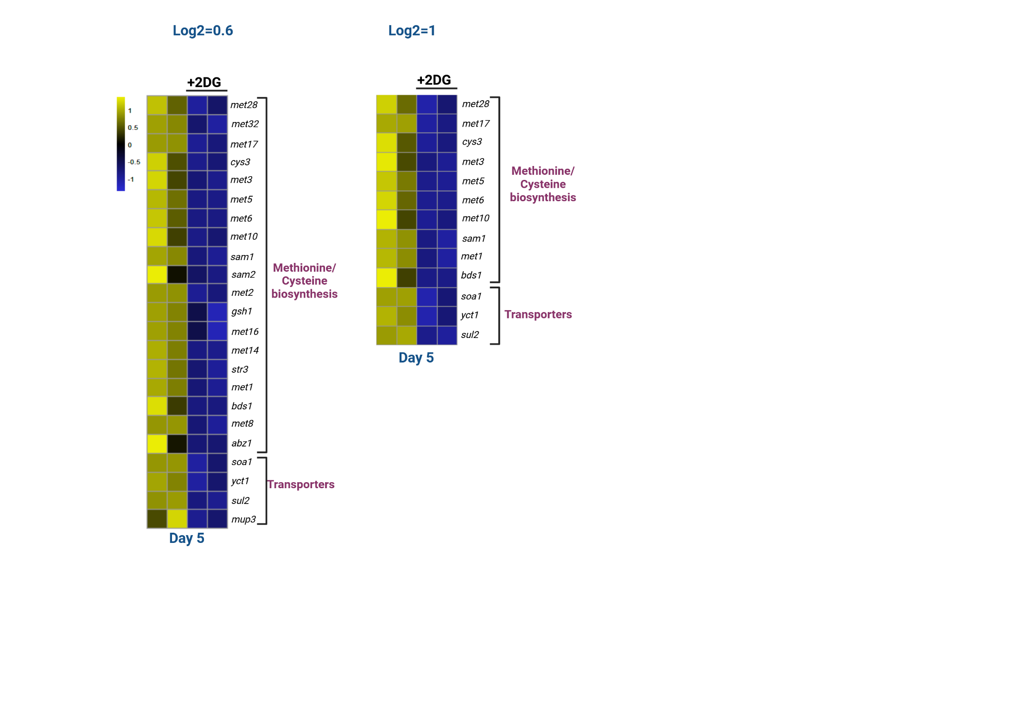
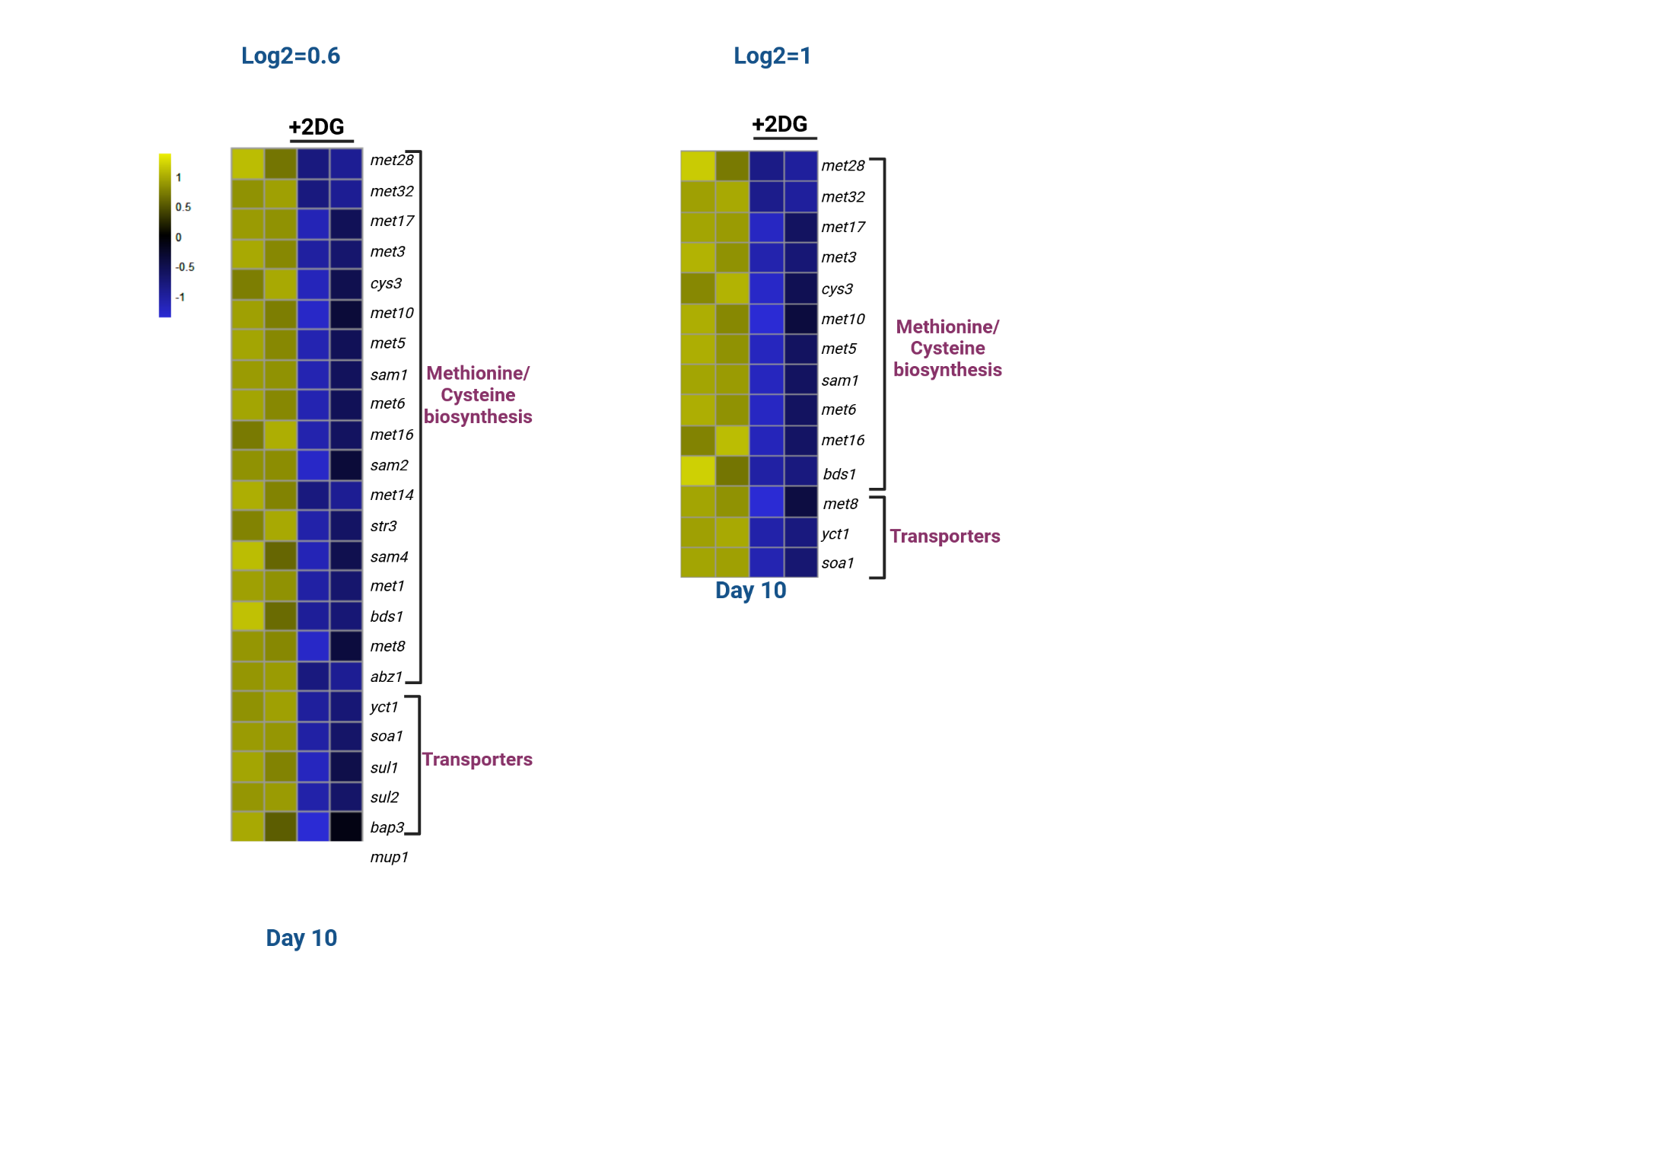
Understanding the Mechanisms Underlying Glucose-mediated Regulation of
Fungal Morphogenesis
Amino acids biosynthesis
Cysteine and methionine biosynthesis pathways
Attenuation of glycolysis causes upregulation of genes involved in amino acids biosynthesis and transporters
Interestingly, genes involved in sulfur assimilation pathway and transport are highly downregulated when glycolysis is inhibited

Slide 14
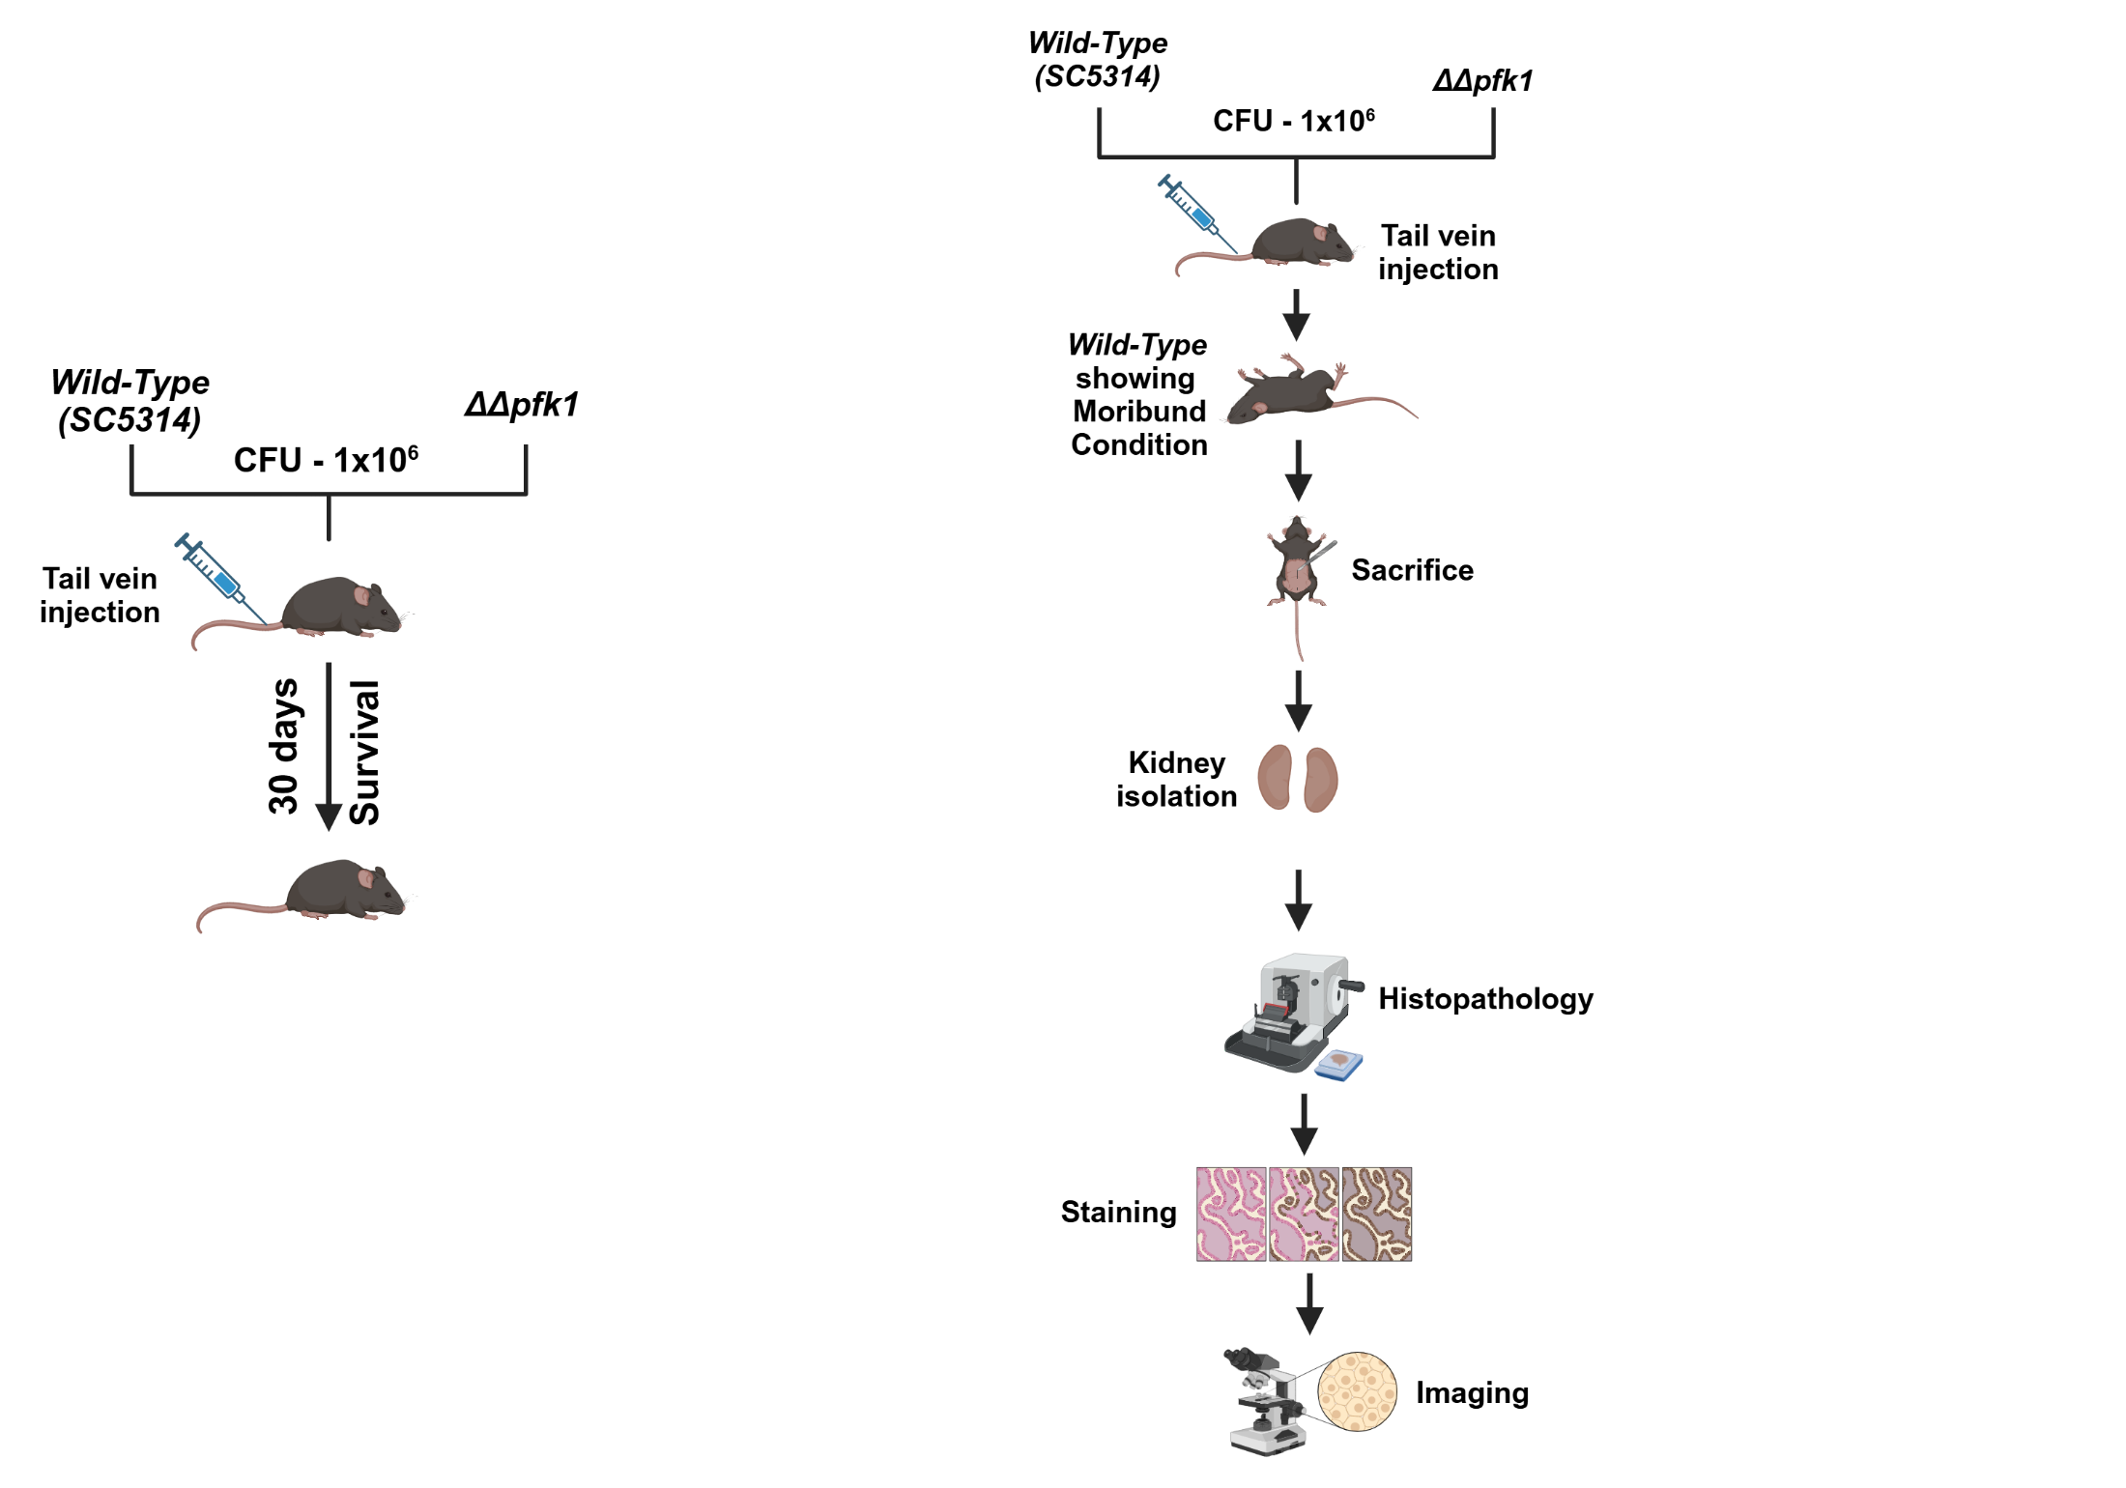
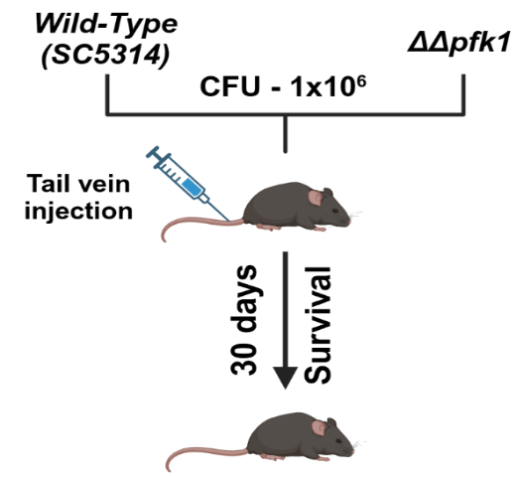
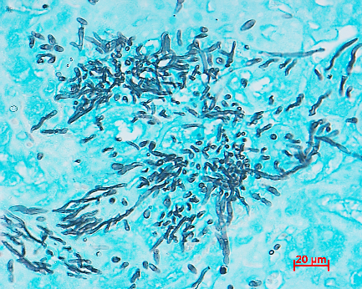
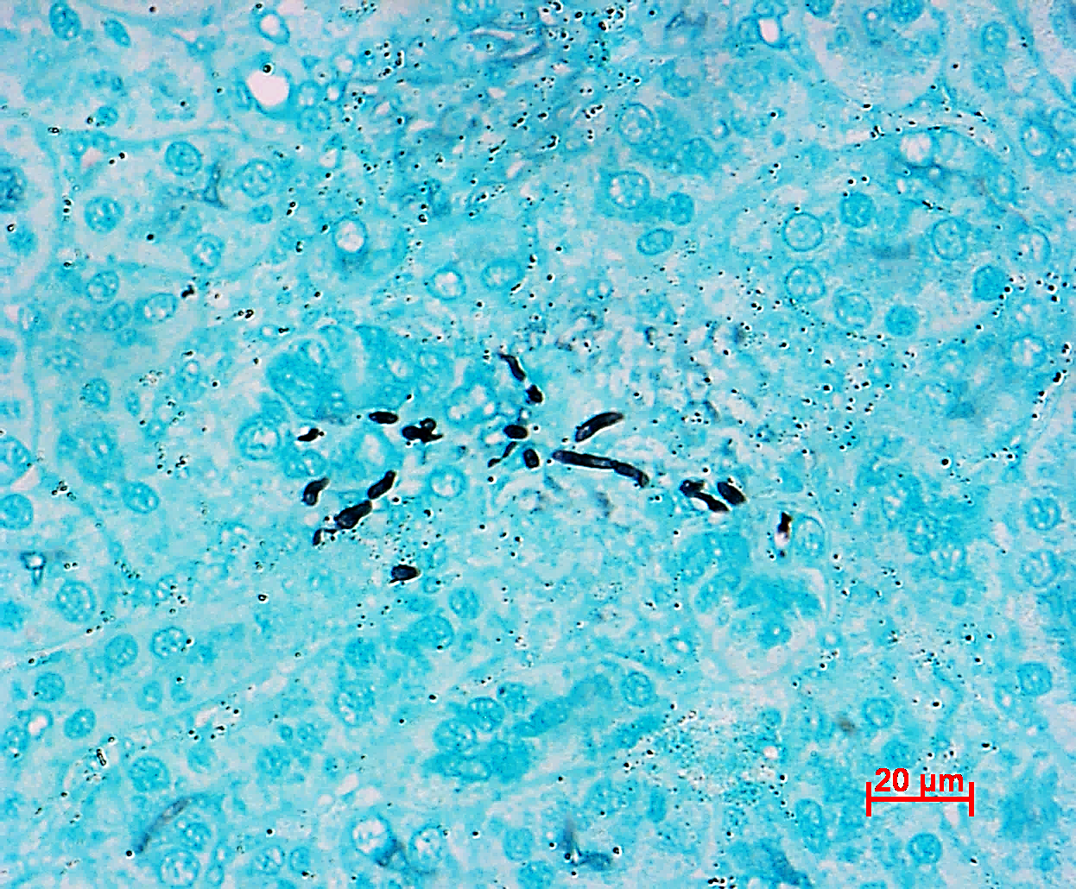
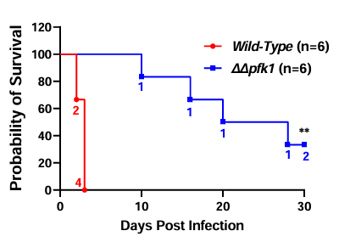
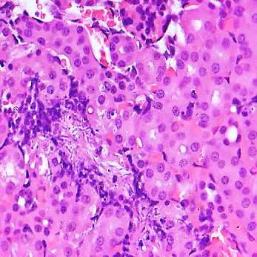
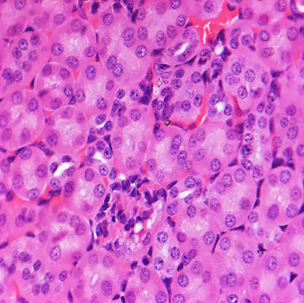
Perturbation of Glycolysis in C. albicans Compromises Pathogenicity in Murine Models
GMS Staining
Wild-Type
ΔΔpfk1
Weight and clinical symptoms has been recorded during study period
Fungal cells
Fungal cells
H & E Staining
Wild-Type
ΔΔpfk1
Immune infiltration
Immune infiltration

Slide 15
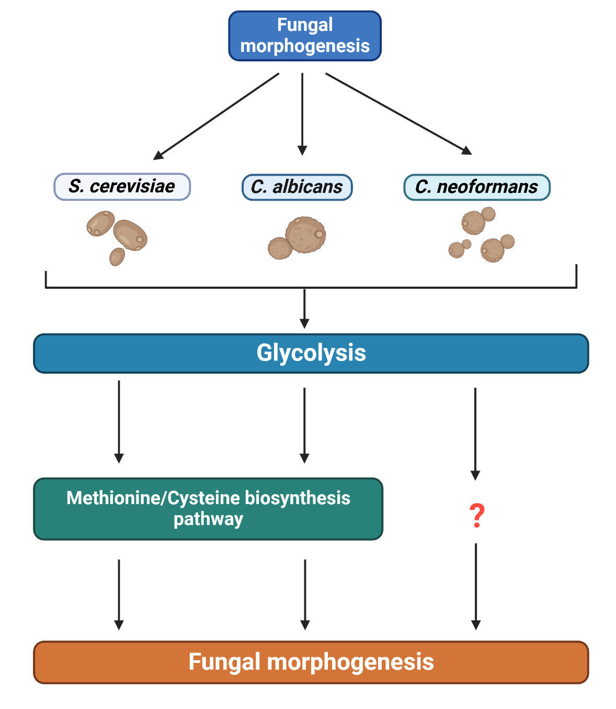
Proposed Model of study

Slide 16




Acknowledgements
Project Supervisor
Dr. Sriram Vrahan
Lab Members
Dhrumi Shah
Dr. Sudharsan M.
Nikita Rewatkar
Dr. Uma Mahto
Pallavi Phatak
Siddhi Gupta
LTS Staff
Narasimhulu
RNA-Seq Analysis
Sree Lakshmi (Dr. Tej Lab)
Manoj (Dr. Ishwariya Lab)
NGS Facility Staff
Funding:

